Slide 1
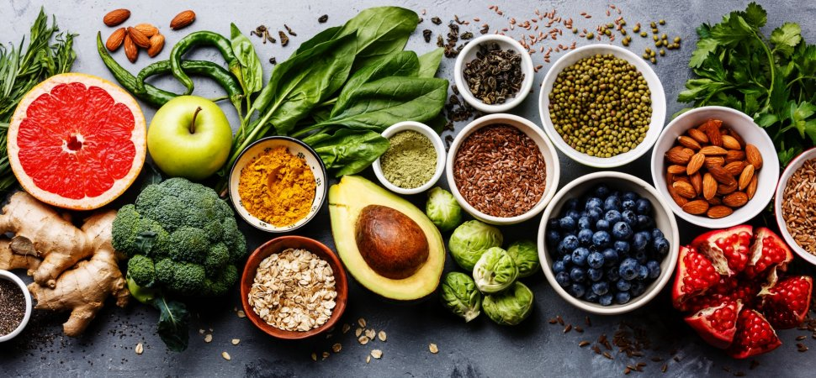
Food Preparation and Nutrition

Slide 2
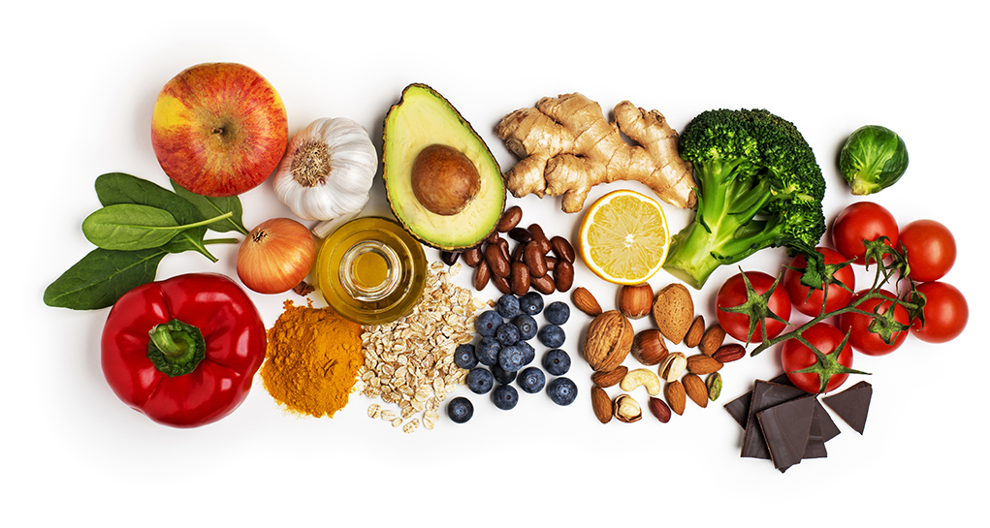
GCSE Specification

Slide 3
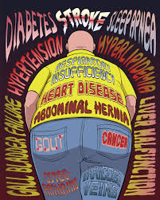
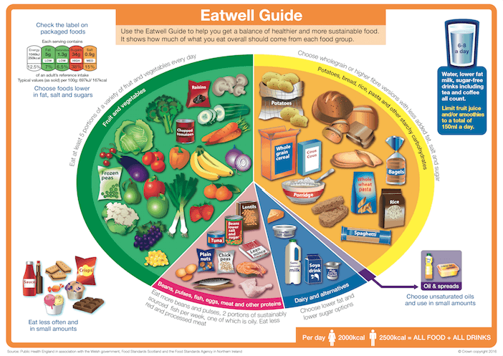
1. Food, Nutrition and Health
What food is composed of, why we need it and how it affects our long term health.

Slide 4
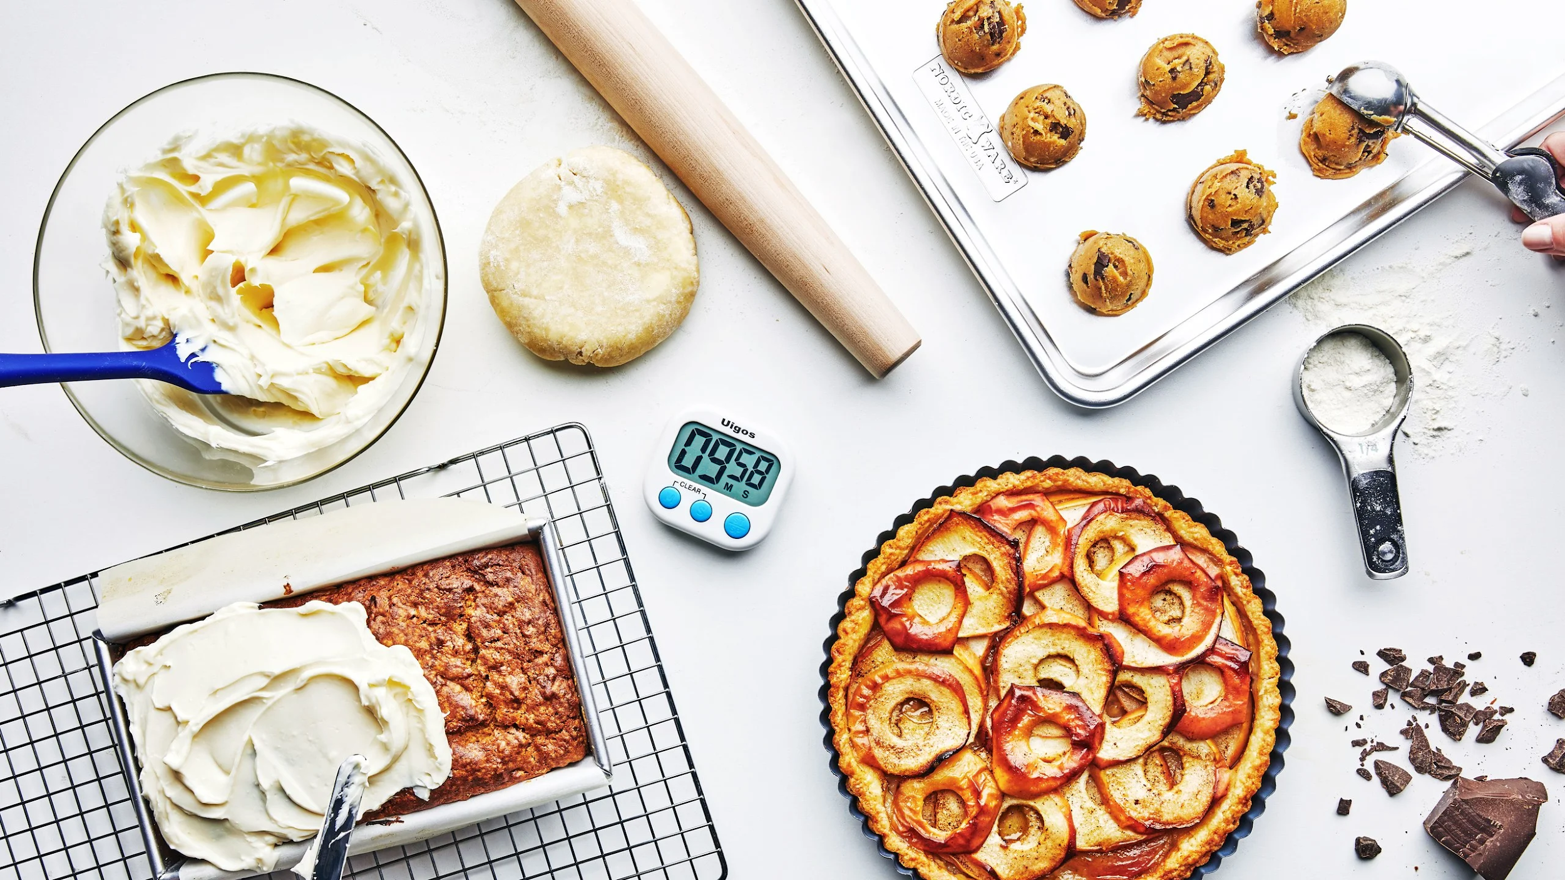
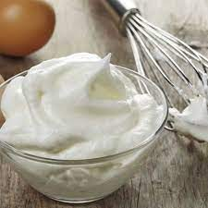
2. Food Science
What happens to the ingredients in food when you prepare and cook them.

Slide 5
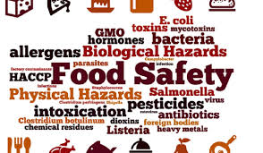
3. Food Safety
How do we store, prepare and cook foods safely and what are the effects of not doing this correctly.

Slide 6
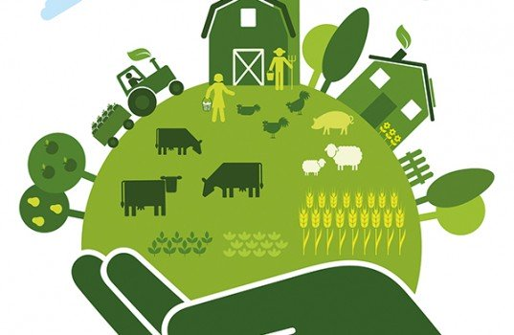
4. Food Choice
How the food choices people make affect the health and well being of themselves and the environment.

Slide 7
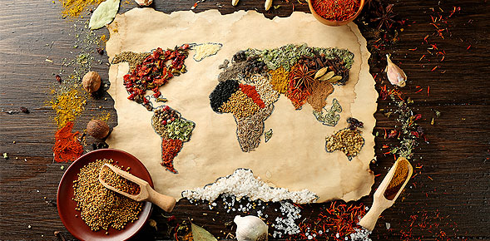
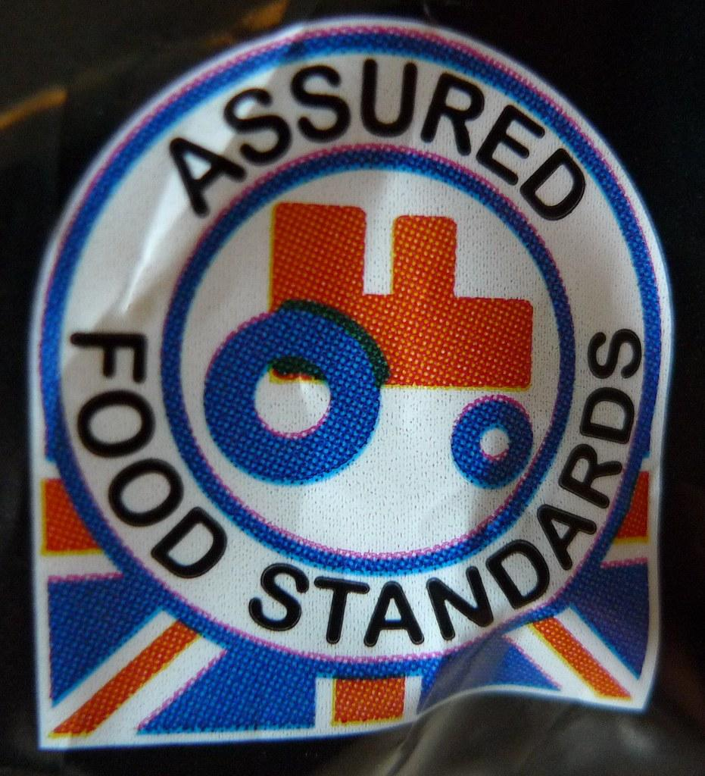
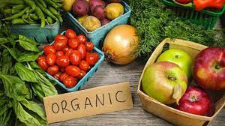
5. Food Provenance
Where food comes from and how it is produced and sold

Slide 8
Practical cooking:
Recipes covering key skills areas, examples could include:
Doughs - bread, pasta, pastry - shortcrust, flaky, choux (turnovers, sausage rolls, profiteroles)
Egg cookery - quiche, meringue, pancakes, omelettes,
Sauces - emulsions, reduction sauces, starch based sauces (mayonnaise, Hollandaise sauce, pesto, ganache, fruit coulis, fruit curd)
Meat - filleting, marinading, roasting, grilling, baking, wrapping,
Fish - filleting, shaping, breading, baking, frying (fish pie, fish cakes)
Meat analogues (alternatives) - quorn, tofu
Setting - protein denaturation, chilling, heating, (cheesecake, ice cream)

Slide 9
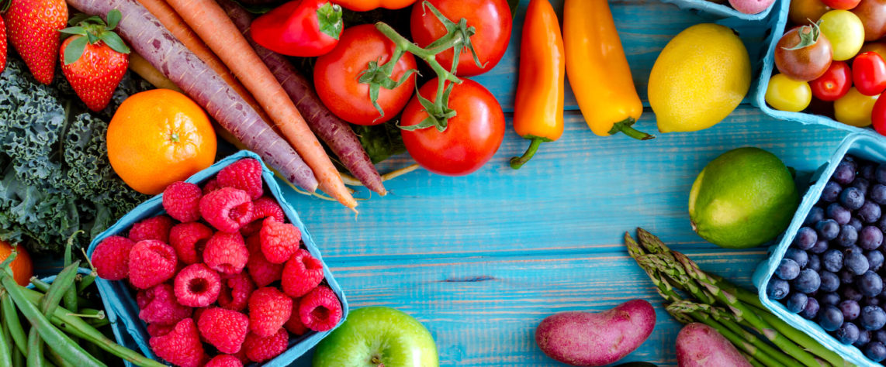
Assessment

Slide 10
NEA (Non-exam assessment) 50% of final grade
NEA 1 - 15% of your final grade
Food Investigation Task
Investigating what is happening when food is prepared and cooked.
NEA 2 - 35% of your final grade
Food Preparation Task
Plan, prepare, cook and present three dishes

Slide 11
Written Exam 50% of final grade
Section A
Multiple choice questions. They test how well you recall information from the different sections.
Section B
There will be a range of questions in this section, with different degrees of difficulty.

