Slide 1
Centre Name: Ringmer Community College Centre Number: 56480
Drop Down day: Thursday 11.05.17
Exam dates: Day 1 Friday 12.05.17 & Day 2 Monday 15.05.17 CONFIRMED
You MUST remember your CANDIDATE NUMBER:
GUIDELINES:
SILENCE in all art rooms S16, S18, S13.
All planning MUST be brought into the exam- Remember what you have been allowed to have prepared before the exam day!!!
Communication between students is NOT permitted- please only communicate with the invigilators/ art staff for materials, support or for assistance.
Only water is permitted into the art exam.
ALL mobile phones will be handed in and kept safe in Art Office- return will ONLY happen at Lunchtime and at end of the day
Any student caught with a mobile phone or communicating will be withdrawn from the exam and be FAILED for this part of the course.
At the end of exam DAY 2 - ALL sketchbooks and preparation will be left in the room NO work will be taken home.
Hour1 | Hour2 | Break/ Mentor | Hour3 | Hour4 | Lunch | Hour5
8:55 | 9:55 | 10:55-11:35 | 11:35 | 12:35 | 13:35-14:20 | 14:20- 15:20
Hour6 | Hour7 | Break only | Hour8 | Hour9 | Lunch | Hour10
8:55 | 9:55 | 10:55-11:15 Do not go to Mentor | 11:15 | 12:35 | 13:35-14:20 | 14:20- 15:00 15:00- packing away

Slide 2
Planning sheet: Name:
Hour1- Organise materials…./ Don’t forget to take photos of your work as it develops. | Hour6
Hour2 | Hour7
Hour3 | Hour8
Hour4 | Hour9
Hour5 | Hour10- Finish Final Piece- Take a final photograph of entire piece ready for my evaluation.

Slide 3
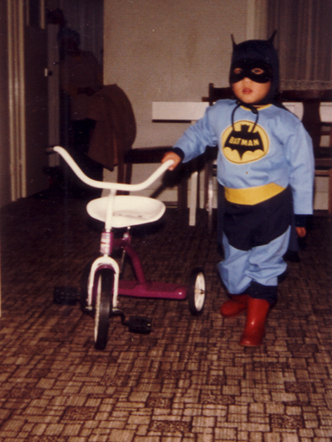
Art exam tips:
DON’T PANIC!!!!!!! Seriously Mr M, Ms B and Sarah are around to help and support
If you do not panic you will NOT fail this exam ☺
You must bring in and complete ALL prep work
Use the planning sheet to organise your thoughts and plan you time properly
Bring in small sweet/ mints to help yourself relax during the day- NOT a full English Breakfast ☺
Do not use pen, sharpie or outline BEFORE you use paint/inks- ONLY after otherwise your work will smudge/ bleed.
Make sure you have practiced all ideas in your book before
Make sure you take photos of your work throughout the exam
KEEP all mixing palettes to stick into your books.
ENJOY the exam- you are doing ART for 2x days YIPPEEEEEEEEEEEEEEEE☺
Don’t worry little BATMAN is here !!!

Slide 4
Topics
1- Detail
2- Out of Place
3- Surroundings
4- Assemble
5- Angles
6- Architecture
7- Shelter
Assessment Objectives | Out of
A01: Artists, influences and analysis | 20
A02: refining ideas and experimenting with materials | 20
A03: recording ideas, appropriate to intentions, drawings, photos | 20
A04: present a personal and informed response, making connections to influences | 20
Total | 80
A* | A | B | C | D | E
76 | 68 | 59 | 49 | 40 | 31

Slide 5
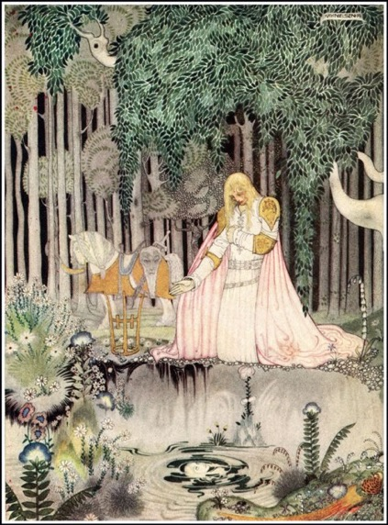
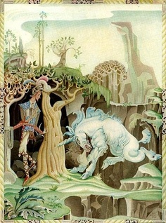
1) Detail: Artists use detail in their work- such artists are Joseph Cornell, Loretta Lux, Yayoi Kusama, Kay Nielsen, Alena Asenbryl, Abigail Hutton, eBoy.
Kay Nielsen: illustrated story scenes think about Red Riding Hood, Mat Hatter, Childhood stories

Slide 6
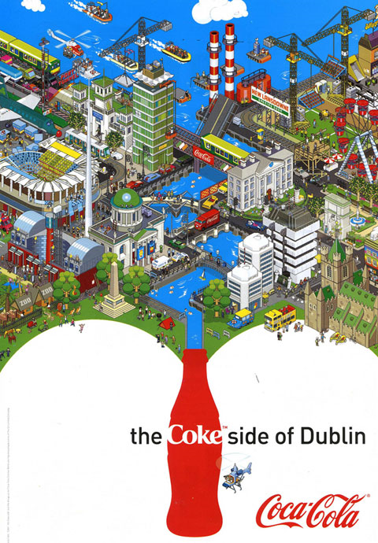
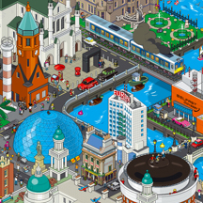
eBoy: Detailed drawings of places, people etc….

Slide 7
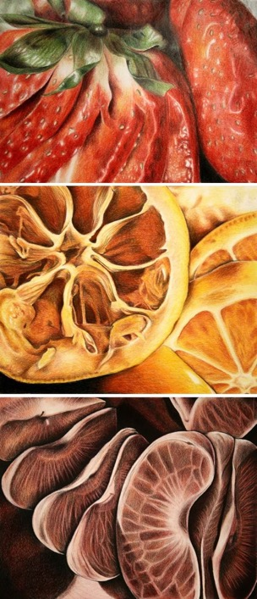
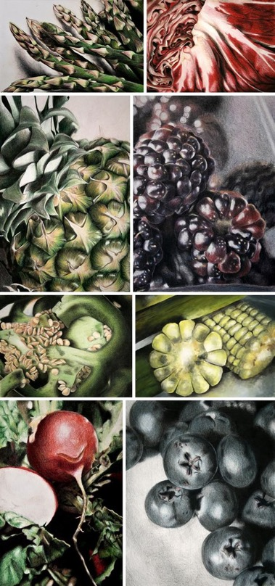
Detail: Close Ups of food, fruit

Slide 8
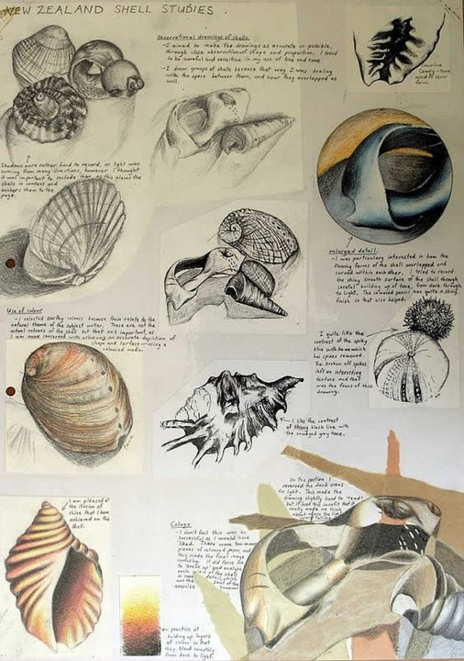
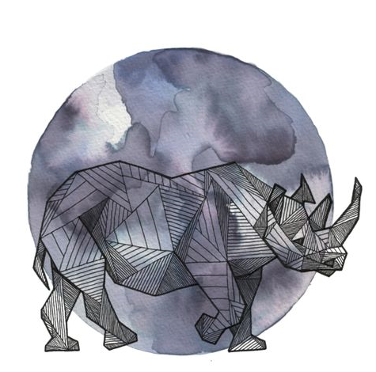
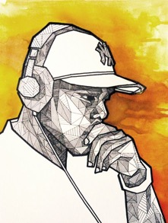
allison kunath
Ink background
With line
Detailed
drawings

Slide 9
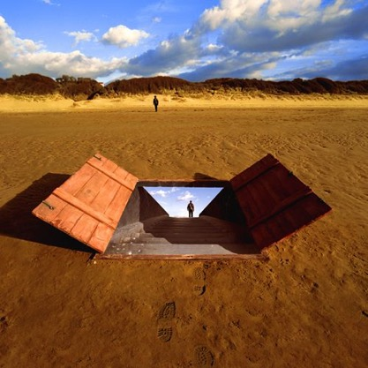
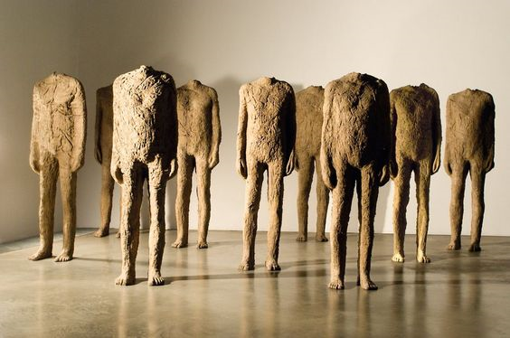
2) Out of Place: Some times objects, people are out of place, Surrealism. Artists such as Rene Magritte, Magdalena Abakanowicz, Antony Gormley, Storm Thorgerson, Wendy McMurdo.
Storm Thorgerson
Magdalena Abakanowicz,

Slide 10
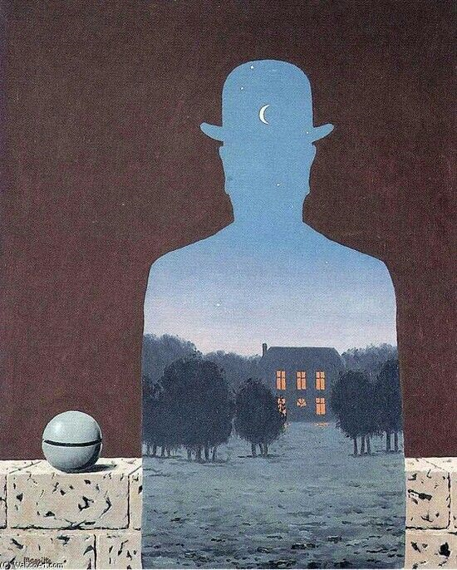
Rene Magritte- Surrealism

Slide 11
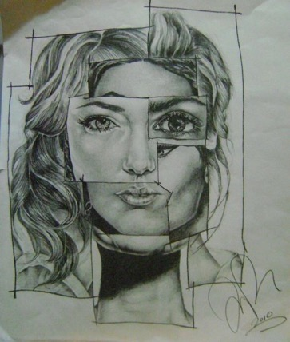
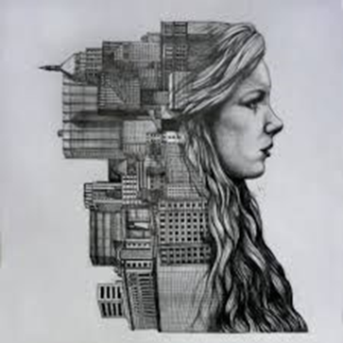
Try this idea: GET lots of images of people, cut them up and place back together… then Mono-print or Carbon PAPER…

Slide 12
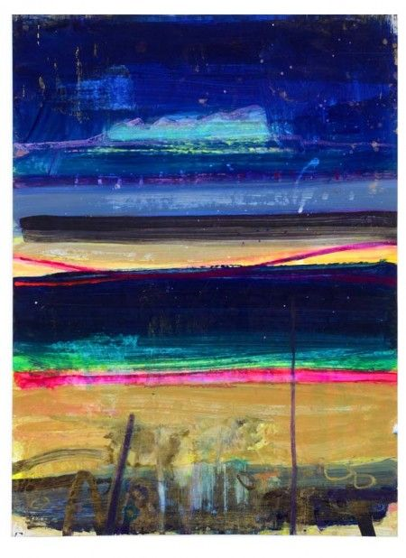
3) Surrounding: inspired by surroundings…Barbara Rae, Michael Kenna, Tony Lattimer, Emesto Neto, Eltono.
Barbara Rae- colourful painted Landscapes

Slide 13
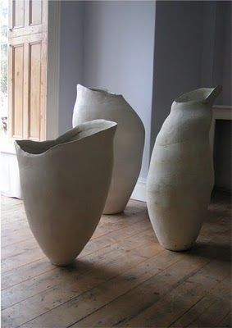
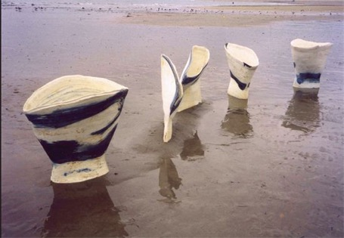
Tony Lattimer- ceramicist: clay work inspired by the sea and shape which surround

Slide 14
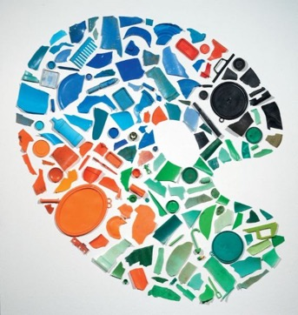
Tony Cragg- British Artist who uses objects to create larger images- LEGO…
4: Assemble: Anselm Kiefer, Kat Button, Jane Fairhurst, Traci Bunkers, Nina Bagley.

Slide 15
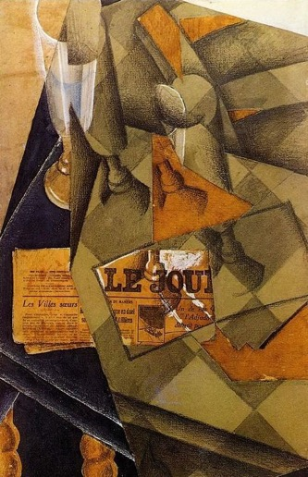
5) Angles: Aurelie Foussard, Juan Gris- Cubism, Nathalie du Pasquier, Alison Britton, Florian Kallus.
Juan Gris- Cubism

Slide 16
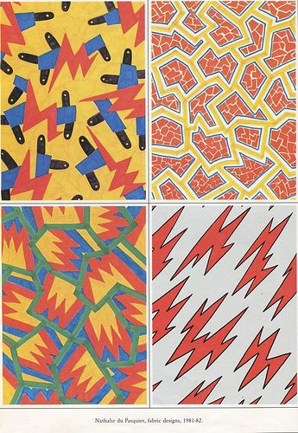
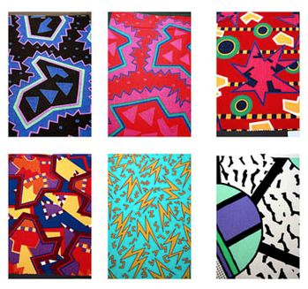
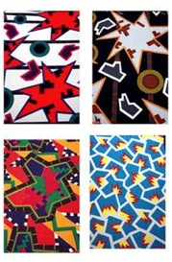
Nathalie du Pasquier

Slide 17
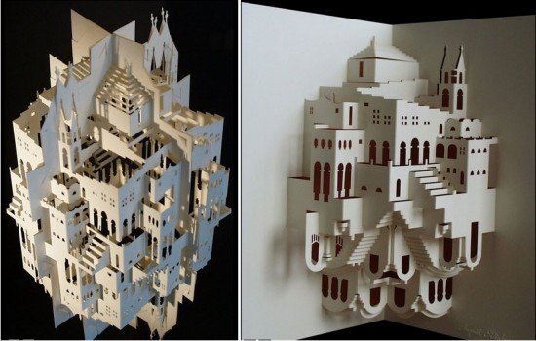
6- Architecture: Ingrid Siliakus, Ettore Sottsass, Richard Estes, John Brickels, Alice Bo-Wen Chang, Dwellings Liesl Pfeffer.
Ingrid Siliakus

Slide 18
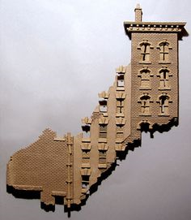
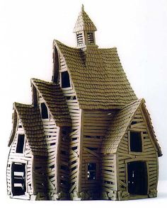
John Brickels: 3d cardbaord scultpure

Slide 19
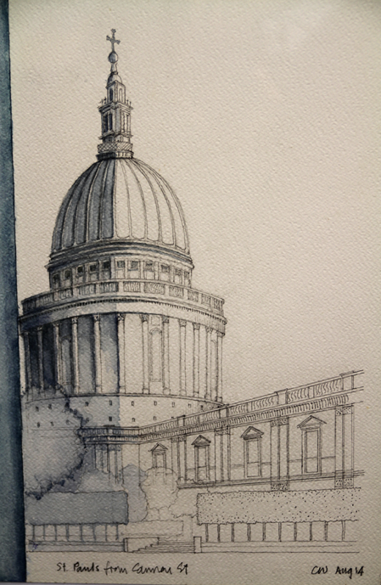
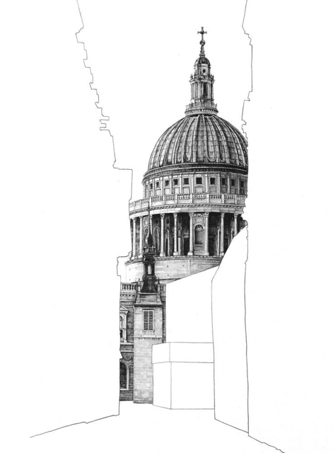

Slide 20
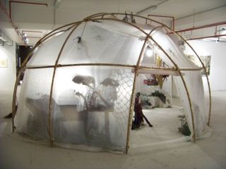
7: Shelter- a) develop your own interpretation of the starting point SHELTER, b) you could create artwork based on ideas of shelter c) you might consider how a shelter covers or encloses an area.

Slide 21
What to do now???
CHOOSE 1 or 2x topics from the exam paper to develop further.
Mr M’s 4x top topics are:
Detail: focusing on detail of objects, still life and line. You can take photos of objects, food, cut up fruit etc…
Out of Place: focusing of faces, places and imagination. You can use magazines, photos, weaving photos to show out of place images…
Surroundings: looking at the Downs, Countryside, the beach, parks, seascape. Take lots of photos…
Architecture: looking at buildings and positive vs negative space. The school building, Ringmer, churches, Lewes, Brighton, London, Eastbourne…
In groups mind map all 7x topics & share…

Slide 22
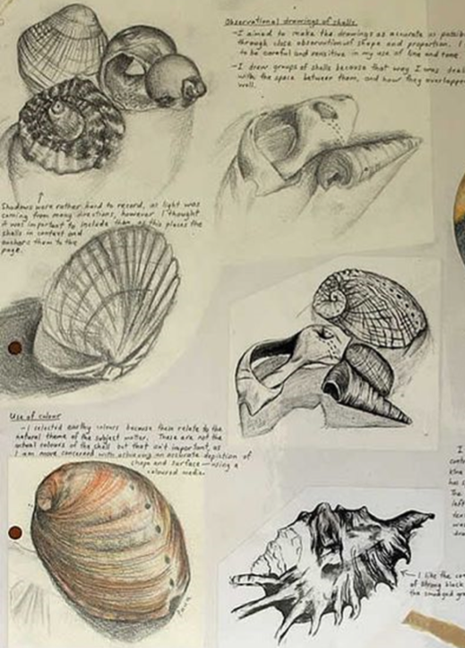
Detail: double page Drawings of shells in pencil, biro, dip pen, potassium paper, carbon paper

Slide 23
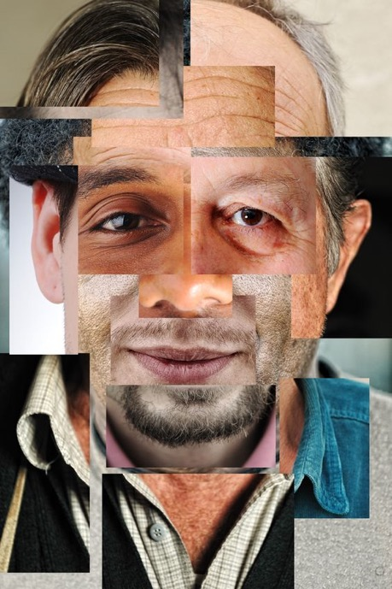
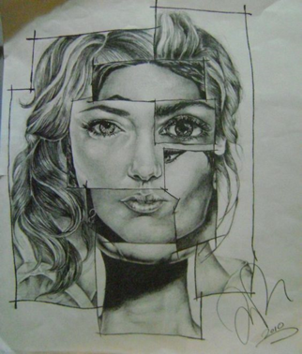
OUT OF PLACE: Using magazine images and 1x Large A3 photo- students are to create their own version- then to mono print/ carbon paper…

Slide 24
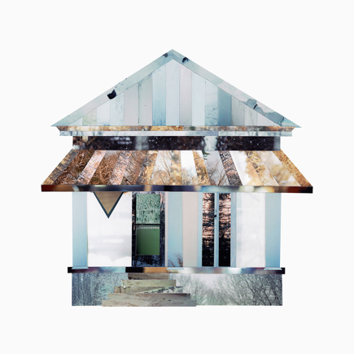
ARCHITECTURE: 1) Looking at buildings- POSITIVE VS NEGATIVE SPACE. Students to get 1x image of a building and ISOLATE 1x building and the rest JUST Line.
2) Creating a building from other photos…

Slide 25
10.01.17 | Single: 1st ½ organising coursework folders/ 2nd ½ Start of exam paper- delivery and initial investigation, Students to mind map in groups. | Hwk- To complete mind maps on 2x themes- then at least 30 words on each mind map Deadline 10.02.17
13.01.17 | Double lesson: P3- Carbon Paper printing, P4 ICT researching images then to email Mr M
20.01.17 | Double lesson on Mono printing. Using sections of images students are to create 2-3x A3 mono prints of either a face, building or place. | Hwk: from Cwk 2x face and 2x scene A4 Carbon paper drawings: Deadline 10.02.17
24.02.17 | Single lesson on 4-6x small/ enlarged sections from photos…using pencil, biro, potassium paper.
27.01.17 | Double lesson: completing cwk from previous lessons | Hwk- students are to decide on 1x theme to develop further, CREATE A TITLE PAGE and then to take 10-20 photos of this theme for lesson 07.02.17
03.02.17 | Double Lesson: MM to select 1x artist per student/ theme- Students to copy artist work in class. | Hwk: research 1x artists on your theme. Create artist pages in your books. These pages must have images, biography, your analysis and 1x response/ version. Deadline 10.02.17
07.02.17 | Double: Continue with response to artist, evaluation and hwk set 03.02.17. + 1-2-1 tutorial of work so far and ½ term hols
10.01.17 | Double: completing all work so far + 1-2-1 tutorial of work so far and ½ term hols | ½ term HOLS hwk- all of the TERM3 checklist and to research 1x artist from Exam Paper!!!

Slide 26
Term3 Checklist
A3 Sketchbook | exam paper stuck in | 2x mind maps in book | 2x A4 carbon paper FACE | 2x A4 carbon paper SCENE | MAIN THEME | A3 Image into 4x Sections | 1st section pencil COPY | 2nd section BIRO on ly | 3rd section enlarged using GRID then colour pencil | 4th section enlarge with protractor then DOTS ONLY | 1st ARTIST linked to theme- research

Slide 27
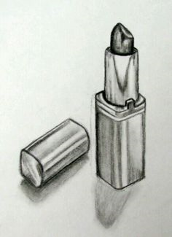
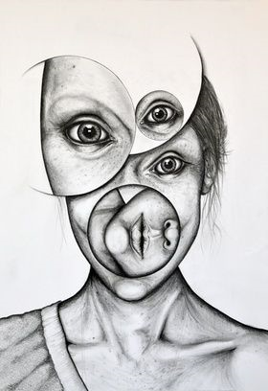
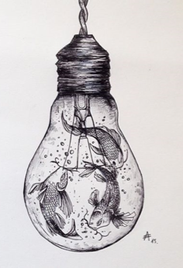
A03- RECORD Workshop
Architecture Drawing example
Out of place FACE
Detail drawing of still life or personal objects
Out of Place Objects

Slide 28
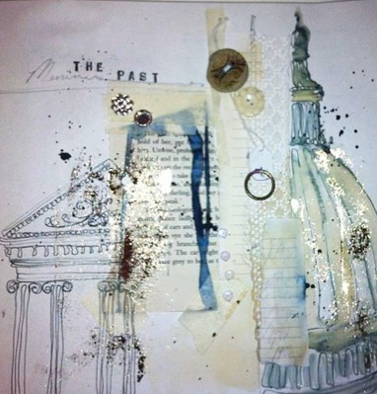
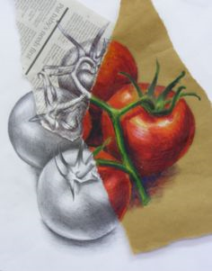
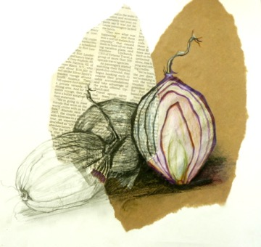
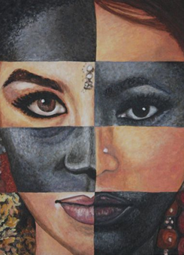

Slide 29
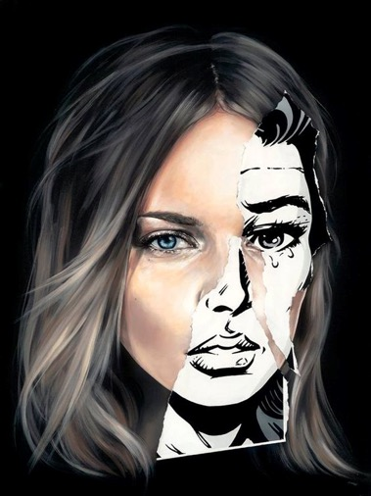
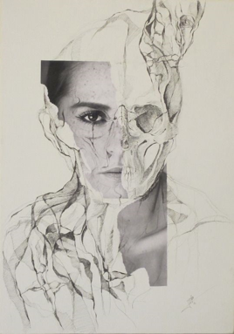
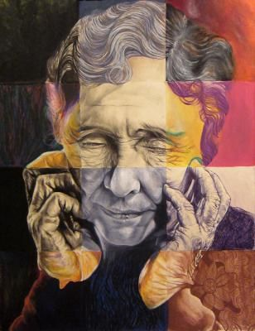
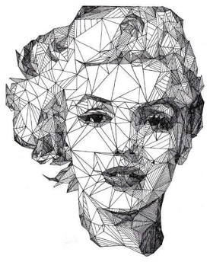
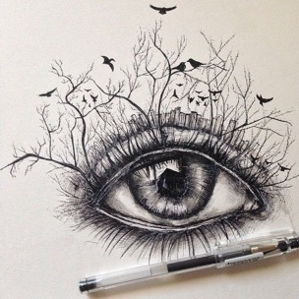
A02: Development of ideas through different media use

