Slide 1
The PiXL Club The PiXL Club The PiXL Club The PiXL Club The PiXL Club The PiXL Club The PiXL Club The PiXL Club The PiXL Club The PiXL Club The PiXL Club The PiXL Club The PiXL Club The PiXL Club The PiXL Club The PiXL Club The PiXL Club The PiXL Club The PiXL Club The PiXL Club The PiXL Club The PiXL Club The PiXL Club The PiXL Club The PiXL Club The PiXL Club The PiXL Club The PiXL Club The PiXL Club The PiXL Club The PiXL Club The PiXL Club The PiXL Club The PiXL Club The PiXL Club The PiXL Club The PiXL Club The PiXL Club The PiXL Club The PiXL Club The PiXL Club The PiXL Club The PiXL Club The PiXL Club The PiXL Club XL Club The PiXL Club The PiXL Club The PiXL Club The PiXL Club The PiXL Club The PiXL Club The PiXL Club The PiXL Club The PiXL Club The PiXL Club The PiXL Club The PiXL Club The PiXL Club The PiXL Club The PiXL Club The PiXL Club The PiXL Club The PiXL Club The PiXL Club The PiXL Club The PiXL Club The PiXL Club The PiXL Club The PiXL Club The PiXL Club The PiXL Club The PiXL Club The PiXL Club The PiXL Club The PiXL Club The PiXL Club The PiXL Club The PiXL Club The PiXL Club The PiXL Club The PiXL Club The PiXL Club The PiXL Club The PiXL Club The PiXL Club The PiXL Club The PiXL Club The PiXL Club The PiXL Club The PiXL Club The PiXL Club The PiXL Club The PiXL Club The PiXL Club The PiXL Club The PiXL Club The PiXL Club The PiXL Club The PiXL Club The PiXL Club The PiXL Club The PiXL Club The PiXL Club The PiXL Club The PiXL Club The PiXL Club The PiXL Club The PiXL Club The PiXL Club The PiXL Club The PiXL Club The PiXL Club The PiXL Club The PiXL Club The PiXL Club The PiXL Club The PiXL Club The PiXL Club The PiXL Club The PiXL Club The PiXL Club The PiXL Club The PiXL Club The PiXL Club The PiXL Club The PiXL Club The PiXL Club The PiXL Club The PiXL Club The PiXL Club The PiXL Club The PiXL Club The PiXL Club The PiXL Club The PiXL Club The PiXL Club The PiXL Club The PiXL Club The PiXL Club The PiXL Club The PiXL Club The PiXL Club The PiXL Club The PiXL Club The PiXL Club The PiXL Club The PiXL Club The PiXL Club The PiXL Club The PiXL Club The PiXL Club The PiXL Club The PiXL Club The PiXL Club The PiXL Club The PiXL Club The PiXL Club The PiXL Club The PiXL Club The PiXL Club The PiXL Club The PiXL Club The PiXL Club The PiXL Club The PiXL Club The PiXL Club The PiXL Club The PiXL Club The PiXL Club The PiXL Club The PiXL Club The PiXL Club The PiXL Club The PiXL Club The PiXL Club The PiXL Club The PiXL Club The PiXL Club The PiXL Club The PiXL Club The PiXL Club The PiXL Club The PiXL Club The PiXL Club The PiXL Club The PiXL Club The PiXL Club The PiXL Club The PiXL Club The PiXL Club The PiXL Club The PiXL Club The PiXL Club The PiXL Club The PiXL Club The PiXL Club The PiXL Club The PiXL Club The PiXL Club The PiXL Club The PiXL Club The PiXL Club The PiXL Club The PiXL Club The PiXL Club The PiXL Club The PiXL Club The PiXL Club The PiXL Club The PiXL Club The PiXL Club The PiXL Club The PiXL Club The PiXL Club The PiXL Club The PiXL Club The PiXL Club The PiXL Club The PiXL Club The PiXL Club The PiXL Club The PiXL Club The PiXL Club The PiXL Club The PiXL Club The PiXL Club The PiXL Club The PiXL Club The PiXL Club The PiXL Club The PiXL Club The PiXL Club The PiXL Club The PiXL Club The PiXL Club The PiXL Club The PiXL Club The PiXL Club The PiXL Club The PiXL Club The PiXL Club The PiXL Club The PiXL Club The PiXL Club The PiXL Club The PiXL Club The PiXL Club The PiXL Club The PiXL Club The PiXL Club The PiXL Club The PiXL Club The PiXL Club The PiXL Club The PiXL Club The PiXL Club The PiXL Club The PiXL Club The PiXL Club The PiXL Club The PiXL Club The PiXL Club The PiXL Club The PiXL Club The PiXL Club The PiXL Club The PiXL Club The PiXL Club The PiXL Club The PiXL Club The PiXL Club The PiXL Club The PiXL Club The PiXL Club The PiXL Club The PiXL Club The PiXL Club The PiXL Club The PiXL Club The PiXL Club The PiXL Club The PiXL Club The PiXL Club The PiXL Club The PiXL Club The PiXL Club The PiXL Club The PiXL Club The PiXL Club The PiXL Club The PiXL Club The PiXL Club The PiXL Club The PiXL Club The PiXL Club The PiXL Club The PiXL Club The PiXL Club The PiXL Club The PiXL Club The PiXL Club The PiXL Club The PiXL Club The PiXL Club The PiXL Club The PiXL Club The PiXL Club The PiXL Club The PiXL Club The PiXL Club The PiXL Club The PiXL Club The PiXL Club The PiXL Club The PiXL Club The PiXL Club The PiXL Club The PiXL Club The PiXL Club The PiXL Club The PiXL Club The PiXL Club The PiXL Club The PiXL Club The PiXL Club The PiXL Club The PiXL Club The PiXL Club The PiXL Club The PiXL Club The PiXL Club The PiXL Club The PiXL Club The PiXL Club The PiXL Club The PiXL Club The PiXL Club The PiXL Club The PiXL Club The PiXL Club The PiXL Club The PiXL Club The PiXL Club The PiXL Club The PiXL Club The PiXL Club The PiXL Club The PiXL Club The PiXL Club The PiXL Club The PiXL Club The PiXL Club The PiXL Club The PiXL Club The PiXL Club The PiXL Club The PiXL Club The PiXL Club The PiXL Club The PiXL Club The PiXL Club The PiXL Club The PiXL Club The PiXL Club The PiXL Club The PiXL Club The PiXL Club The PiXL Club The PiXL Club The PiXL Club The PiXL Club The PiXL Club The PiXL Club The PiXL Club The PiXL Club The PiXL Club The PiXL Club The PiXL Club The PiXL Club The PiXL Club The PiXL Club The PiXL Club The PiXL Club The PiXL Club The PiXL Club The PiXL Club The PiXL Club The PiXL Club The PiXL Club The PiXL Club The PiXL Club The PiXL Club The PiXL Club The PiXL Club The PiXL Club The PiXL Club The PiXL Club The PiXL Club The PiXL Club The PiXL Club The PiXL Club The PiXL Club The PiXL Club The PiXL Club The PiXL Club The PiXL Club The PiXL Club The PiXL Club The PiXL Club The PiXL Club The PiXL Club The PiXL Club The PiXL Club The PiXL Club The PiXL Club The PiXL Club The PiXL Club The PiXL Club The PiXL Club The PiXL Club The PiXL Club The PiXL Club The PiXL Club The PiXL Club The PiXL Club The PiXL Club The PiXL Club The PiXL Club The PiXL Club The PiXL Club The PiXL Club The PiXL Club The PiXL Club The PiXL Club The PiXL Club The PiXL Club The PiXL Club The PiXL Club The PiXL Club The PiXL Club The PiXL Club The PiXL Club The PiXL Club The PiXL Club The PiXL Club The PiXL Club The PiXL Club The PiXL Club The PiXL Club The PiXL Club The PiXL Club The PiXL Club The PiXL Club The PiXL Club The PiXL Club The PiXL Club The PiXL Club The PiXL Club The PiXL Club The PiXL Club The PiXL Club The PiXL Club The PiXL Club The PiXL Club The PiXL Club The PiXL Club The PiXL Club The PiXL Club The PiXL Club The PiXL Club The PiXL Club The PiXL Club The PiXL Club The PiXL Club The PiXL Club The PiXL Club The PiXL Club The PiXL Club The PiXL Club The PiXL Club The PiXL Club The PiXL Club The PiXL Club The PiXL Club The PiXL Club The PiXL Club The PiXL Club The PiXL Club The PiXL Club The PiXL Club The PiXL Club The PiXL Club The PiXL Club The PiXL Club The PiXL Club The PiXL Club The PiXL Club The PiXL Club The PiXL Club The PiXL Club The PiXL Club The PiXL Club The PiXL Club The PiXL Club The PiXL Club The PiXL Club The PiXL Club The PiXL Club The PiXL Club The PiXL Club The PiXL Club The PiXL Club The PiXL Club The PiXL Club The PiXL Club The PiXL Club The PiXL Club The PiXL Club The PiXL Club The PiXL Club The PiXL Club The PiXL Club The PiXL Club The PiXL Club The PiXL Club The PiXL Club The PiXL Club The PiXL Club The PiXL Club The PiXL Club The PiXL Club The PiXL Club The PiXL Club The PiXL Club The PiXL Club The PiXL Club The PiXL Club The PiXL Club The PiXL Club The PiXL Club The PiXL Club The PiXL Club The PiXL Club The PiXL Club The PiXL Club The PiXL Club The PiXL Club The PiXL Club The PiXL Club The PiXL Club The PiXL Club The PiXL Club The PiXL Club The PiXL Club The PiXL Club The PiXL Club The PiXL Club The PiXL Club The PiXL Club The PiXL Club The PiXL Club The PiXL Club The PiXL Club The PiXL Club The PiXL Club The PiXL Club The PiXL Club The PiXL Club The PiXL Club The PiXL Club The PiXL Club The PiXL Club The PiXL Club The PiXL Club The PiXL Club The PiXL Club The PiXL Club The PiXL Club The PiXL Club The PiXL Club The PiXL Club The PiXL Club The PiXL Club The PiXL Club The PiXL Club The PiXL Club The PiXL Club The PiXL Club The PiXL Club The PiXL Club The PiXL Club The PiXL Club The PiXL Club The PiXL Club The PiXL Club The PiXL Club The PiXL Club The PiXL Club The PiXL Club The PiXL Club The PiXL Club The PiXL Club The PiXL Club The PiXL Club The PiXL Club The PiXL Club The PiXL Club The PiXL Club The PiXL Club The PiXL Club The PiXL Club The PiXL Club The PiXL Club The PiXL Club The PiXL Club The PiXL Club The PiXL Club The PiXL Club The PiXL Club The PiXL Club The PiXL Club The PiXL Club The PiXL Club The PiXL Club The PiXL Club The PiXL Club The PiXL Club The PiXL Club The PiXL Club The PiXL Club The PiXL Club The PiXL Club The PiXL Club The PiXL Club The PiXL Club The PiXL Club The PiXL Club The PiXL Club The PiXL Club The PiXL Club The PiXL Club The PiXL Club The PiXL Club The PiXL Club The PiXL Club The PiXL Club The PiXL Club The PiXL Club The PiXL Club The PiXL Club The PiXL Club The PiXL Club The PiXL Club The PiXL Club The PiXL Club The PiXL Club The PiXL Club The PiXL Club The PiXL Club The PiXL Club The PiXL Club The PiXL Club The PiXL Club The PiXL Club The PiXL Club The PiXL Club The PiXL Club The PiXL Club The PiXL Club The PiXL Club The PiXL Club The PiXL Club The PiXL Club The PiXL Club The PiXL Club The PiXL Club The PiXL Club The PiXL Club The PiXL Club The PiXL Club The PiXL Club The PiXL Club The PiXL Club The PiXL Club The PiXL Club The PiXL Club The PiXL Club The PiXL Club The PiXL Club The PiXL Club The PiXL Club The PiXL Club The PiXL Club The PiXL Club The PiXL Club The PiXL Club The PiXL Club The PiXL Club The PiXL Club The PiXL Club The PiXL Club The PiXL Club The PiXL Club The PiXL Club The PiXL Club The PiXL Club The PiXL Club The PiXL Club The PiXL Club The PiXL Club The PiXL Club The PiXL Club The PiXL Club The PiXL Club The PiXL Club The PiXL Club The PiXL Club The PiXL Club The PiXL Club The PiXL Club The PiXL Club The PiXL Club The PiXL Club The PiXL Club The PiXL Club The PiXL Club The PiXL Club The PiXL Club The PiXL Club The PiXL Club The PiXL Club The PiXL Club The PiXL Club The PiXL Club The PiXL Club The PiXL Club The PiXL Club The PiXL Club The PiXL Club The PiXL Club The PiXL Club The PiXL Club The PiXL Club The PiXL Club The PiXL Club
PiXL GetIT!
GCSE Biology
Topic – Cell Biology
© Copyright The PiXL Club Ltd, 2017
This resource is strictly for the use of member schools for as long as they remain members of The PiXL Club. It may not be copied, sold nor transferred to a third party or used by the school after membership ceases. Until such time it may be freely used within the member school.
All opinions and contributions are those of the authors. The contents of this resource are not connected with nor endorsed by any other company, organisation or institution.
www.pixl.org.uk The PiXL Club Ltd, Company number 07321607

Slide 2
GetIT – Cell structure
All living things are made of cells, they are the basic unit of all life
Eu = True Pro = Before Karyo = Nut (Nucleus)
Eukaryotic cells
Prokaryotic cells

Slide 3
Match IT
Cell membrane |  | Contains genetic material, DNA
Cell wall |  | Site of aerobic respiration
Chloroplast |  | Small ring of DNA found in bacterial cells
Cytoplasm |  | Surrounds the cell, provides strength
Nucleus |  | Thin layer around a cell controlling the substances passing in and out
Vacuole |  | Site of protein synthesis
Mitochondria |  | Material inside a cell where most chemical reactions take place
Ribosome |  | Contains chlorophyll, for photosynthesis
Plasmid |  | Space filled with cell sap in the cytoplasm

Slide 4
Match IT - Answers
Cell membrane |  | Thin layer around a cell controlling the substances passing in and out
Cell wall |  | Surrounds the cell, provides strength
Chloroplast |  | Contains chlorophyll, for photosynthesis
Cytoplasm |  | Material inside a cell where most chemical reactions take place
Nucleus |  | Contains genetic material, DNA
Vacuole |  | Space filled with cell sap in the cytoplasm
Mitochondria |  | Site of aerobic respiration
Ribosome |  | Site of protein synthesis
Plasmid |  | Small ring of DNA found in bacterial cells

Slide 5
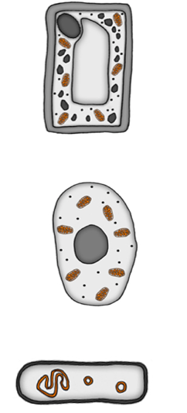
Label IT

Slide 6
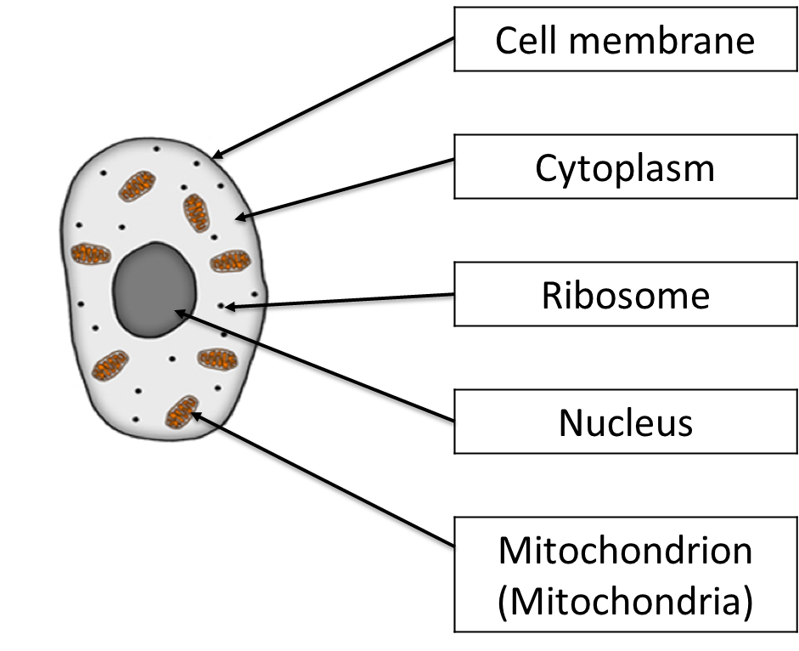
Label IT - Answers

Slide 7
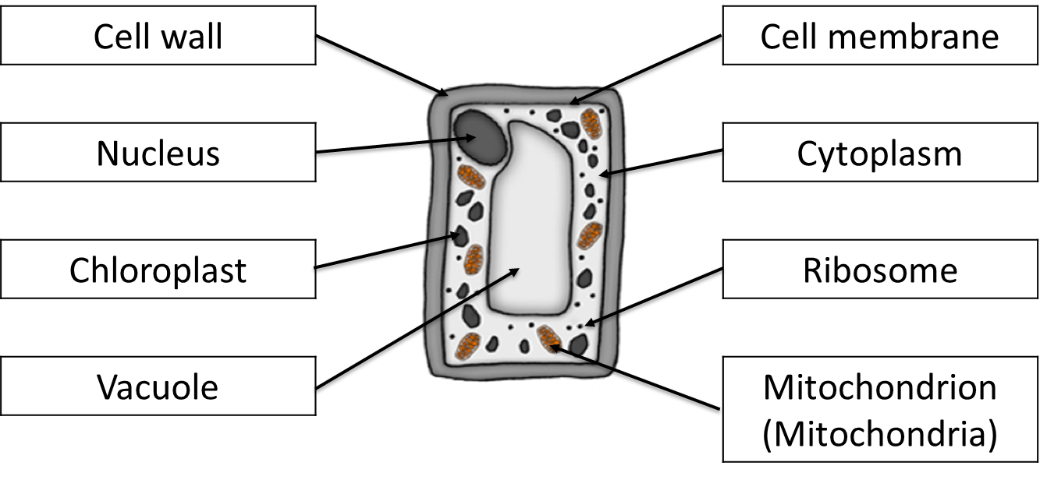
Label IT - Answers

Slide 8
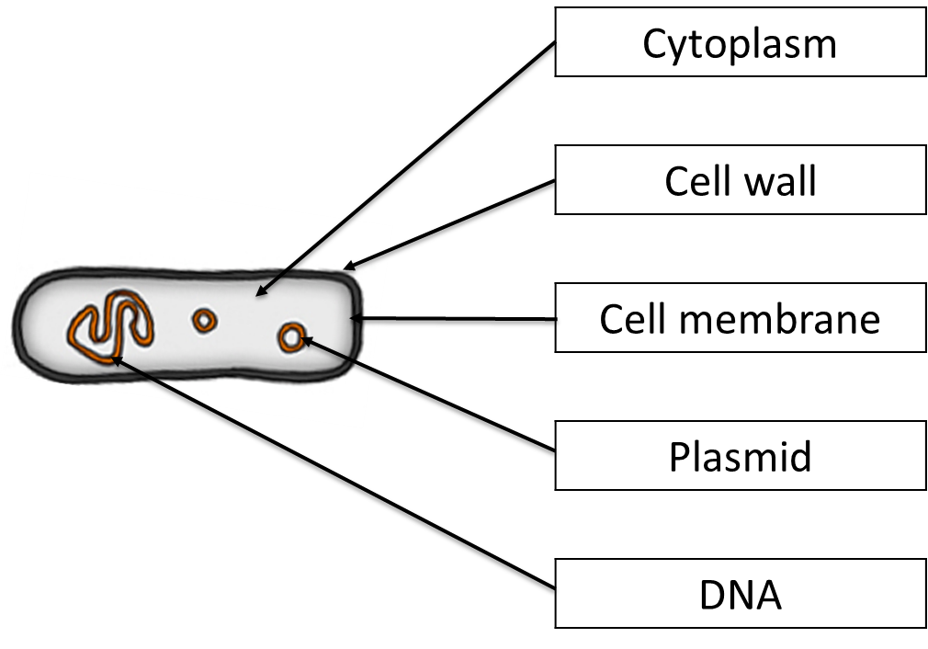
Label IT - Answers

Slide 9
GetIT – Cell structure
Cell membrane
Cell wall
Chloroplast
Cytoplasm
Nucleus
Vacuole
Mitochondria
Ribosome
Plasmid
Cell membrane
Cell wall
Chloroplast
Cytoplasm
Nucleus
Vacuole
Mitochondria
Ribosome
Plasmid
Cell membrane
Cell wall
Chloroplast
Cytoplasm
Nucleus
Vacuole
Mitochondria
Ribosome
Plasmid
Colour in green the organelles which are found in a plant cell not an animal cell.
Colour in orange the organelles which are found in a bacterial cell.

Slide 10
The PiXL Club The PiXL Club The PiXL Club The PiXL Club The PiXL Club The PiXL Club The PiXL Club The PiXL Club The PiXL Club The PiXL Club The PiXL Club The PiXL Club The PiXL Club The PiXL Club The PiXL Club The PiXL Club The PiXL Club The PiXL Club The PiXL Club The PiXL Club The PiXL Club The PiXL Club The PiXL Club The PiXL Club The PiXL Club The PiXL Club The PiXL Club The PiXL Club The PiXL Club The PiXL Club The PiXL Club The PiXL Club The PiXL Club The PiXL Club The PiXL Club The PiXL Club The PiXL Club The PiXL Club The PiXL Club The PiXL Club The PiXL Club The PiXL Club The PiXL Club The PiXL Club The PiXL Club XL Club The PiXL Club The PiXL Club The PiXL Club The PiXL Club The PiXL Club The PiXL Club The PiXL Club The PiXL Club The PiXL Club The PiXL Club The PiXL Club The PiXL Club The PiXL Club The PiXL Club The PiXL Club The PiXL Club The PiXL Club The PiXL Club The PiXL Club The PiXL Club The PiXL Club The PiXL Club The PiXL Club The PiXL Club The PiXL Club The PiXL Club The PiXL Club The PiXL Club The PiXL Club The PiXL Club The PiXL Club The PiXL Club The PiXL Club The PiXL Club The PiXL Club The PiXL Club The PiXL Club The PiXL Club The PiXL Club The PiXL Club The PiXL Club The PiXL Club The PiXL Club The PiXL Club The PiXL Club The PiXL Club The PiXL Club The PiXL Club The PiXL Club The PiXL Club The PiXL Club The PiXL Club The PiXL Club The PiXL Club The PiXL Club The PiXL Club The PiXL Club The PiXL Club The PiXL Club The PiXL Club The PiXL Club The PiXL Club The PiXL Club The PiXL Club The PiXL Club The PiXL Club The PiXL Club The PiXL Club The PiXL Club The PiXL Club The PiXL Club The PiXL Club The PiXL Club The PiXL Club The PiXL Club The PiXL Club The PiXL Club The PiXL Club The PiXL Club The PiXL Club The PiXL Club The PiXL Club The PiXL Club The PiXL Club The PiXL Club The PiXL Club The PiXL Club The PiXL Club The PiXL Club The PiXL Club The PiXL Club The PiXL Club The PiXL Club The PiXL Club The PiXL Club The PiXL Club The PiXL Club The PiXL Club The PiXL Club The PiXL Club The PiXL Club The PiXL Club The PiXL Club The PiXL Club The PiXL Club The PiXL Club The PiXL Club The PiXL Club The PiXL Club The PiXL Club The PiXL Club The PiXL Club The PiXL Club The PiXL Club The PiXL Club The PiXL Club The PiXL Club The PiXL Club The PiXL Club The PiXL Club The PiXL Club The PiXL Club The PiXL Club The PiXL Club The PiXL Club The PiXL Club The PiXL Club The PiXL Club The PiXL Club The PiXL Club The PiXL Club The PiXL Club The PiXL Club The PiXL Club The PiXL Club The PiXL Club The PiXL Club The PiXL Club The PiXL Club The PiXL Club The PiXL Club The PiXL Club The PiXL Club The PiXL Club The PiXL Club The PiXL Club The PiXL Club The PiXL Club The PiXL Club The PiXL Club The PiXL Club The PiXL Club The PiXL Club The PiXL Club The PiXL Club The PiXL Club The PiXL Club The PiXL Club The PiXL Club The PiXL Club The PiXL Club The PiXL Club The PiXL Club The PiXL Club The PiXL Club The PiXL Club The PiXL Club The PiXL Club The PiXL Club The PiXL Club The PiXL Club The PiXL Club The PiXL Club The PiXL Club The PiXL Club The PiXL Club The PiXL Club The PiXL Club The PiXL Club The PiXL Club The PiXL Club The PiXL Club The PiXL Club The PiXL Club The PiXL Club The PiXL Club The PiXL Club The PiXL Club The PiXL Club The PiXL Club The PiXL Club The PiXL Club The PiXL Club The PiXL Club The PiXL Club The PiXL Club The PiXL Club The PiXL Club The PiXL Club The PiXL Club The PiXL Club The PiXL Club The PiXL Club The PiXL Club The PiXL Club The PiXL Club The PiXL Club The PiXL Club The PiXL Club The PiXL Club The PiXL Club The PiXL Club The PiXL Club The PiXL Club The PiXL Club The PiXL Club The PiXL Club The PiXL Club The PiXL Club The PiXL Club The PiXL Club The PiXL Club The PiXL Club The PiXL Club The PiXL Club The PiXL Club The PiXL Club The PiXL Club The PiXL Club The PiXL Club The PiXL Club The PiXL Club The PiXL Club The PiXL Club The PiXL Club The PiXL Club The PiXL Club The PiXL Club The PiXL Club The PiXL Club The PiXL Club The PiXL Club The PiXL Club The PiXL Club The PiXL Club The PiXL Club The PiXL Club The PiXL Club The PiXL Club The PiXL Club The PiXL Club The PiXL Club The PiXL Club The PiXL Club The PiXL Club The PiXL Club The PiXL Club The PiXL Club The PiXL Club The PiXL Club The PiXL Club The PiXL Club The PiXL Club The PiXL Club The PiXL Club The PiXL Club The PiXL Club The PiXL Club The PiXL Club The PiXL Club The PiXL Club The PiXL Club The PiXL Club The PiXL Club The PiXL Club The PiXL Club The PiXL Club The PiXL Club The PiXL Club The PiXL Club The PiXL Club The PiXL Club The PiXL Club The PiXL Club The PiXL Club The PiXL Club The PiXL Club The PiXL Club The PiXL Club The PiXL Club The PiXL Club The PiXL Club The PiXL Club The PiXL Club The PiXL Club The PiXL Club The PiXL Club The PiXL Club The PiXL Club The PiXL Club The PiXL Club The PiXL Club The PiXL Club The PiXL Club The PiXL Club The PiXL Club The PiXL Club The PiXL Club The PiXL Club The PiXL Club The PiXL Club The PiXL Club The PiXL Club The PiXL Club The PiXL Club The PiXL Club The PiXL Club The PiXL Club The PiXL Club The PiXL Club The PiXL Club The PiXL Club The PiXL Club The PiXL Club The PiXL Club The PiXL Club The PiXL Club The PiXL Club The PiXL Club The PiXL Club The PiXL Club The PiXL Club The PiXL Club The PiXL Club The PiXL Club The PiXL Club The PiXL Club The PiXL Club The PiXL Club The PiXL Club The PiXL Club The PiXL Club The PiXL Club The PiXL Club The PiXL Club The PiXL Club The PiXL Club The PiXL Club The PiXL Club The PiXL Club The PiXL Club The PiXL Club The PiXL Club The PiXL Club The PiXL Club The PiXL Club The PiXL Club The PiXL Club The PiXL Club The PiXL Club The PiXL Club The PiXL Club The PiXL Club The PiXL Club The PiXL Club The PiXL Club The PiXL Club The PiXL Club The PiXL Club The PiXL Club The PiXL Club The PiXL Club The PiXL Club The PiXL Club The PiXL Club The PiXL Club The PiXL Club The PiXL Club The PiXL Club The PiXL Club The PiXL Club The PiXL Club The PiXL Club The PiXL Club The PiXL Club The PiXL Club The PiXL Club The PiXL Club The PiXL Club The PiXL Club The PiXL Club The PiXL Club The PiXL Club The PiXL Club The PiXL Club The PiXL Club The PiXL Club The PiXL Club The PiXL Club The PiXL Club The PiXL Club The PiXL Club The PiXL Club The PiXL Club The PiXL Club The PiXL Club The PiXL Club The PiXL Club The PiXL Club The PiXL Club The PiXL Club The PiXL Club The PiXL Club The PiXL Club The PiXL Club The PiXL Club The PiXL Club The PiXL Club The PiXL Club The PiXL Club The PiXL Club The PiXL Club The PiXL Club The PiXL Club The PiXL Club The PiXL Club The PiXL Club The PiXL Club The PiXL Club The PiXL Club The PiXL Club The PiXL Club The PiXL Club The PiXL Club The PiXL Club The PiXL Club The PiXL Club The PiXL Club The PiXL Club The PiXL Club The PiXL Club The PiXL Club The PiXL Club The PiXL Club The PiXL Club The PiXL Club The PiXL Club The PiXL Club The PiXL Club The PiXL Club The PiXL Club The PiXL Club The PiXL Club The PiXL Club The PiXL Club The PiXL Club The PiXL Club The PiXL Club The PiXL Club The PiXL Club The PiXL Club The PiXL Club The PiXL Club The PiXL Club The PiXL Club The PiXL Club The PiXL Club The PiXL Club The PiXL Club The PiXL Club The PiXL Club The PiXL Club The PiXL Club The PiXL Club The PiXL Club The PiXL Club The PiXL Club The PiXL Club The PiXL Club The PiXL Club The PiXL Club The PiXL Club The PiXL Club The PiXL Club The PiXL Club The PiXL Club The PiXL Club The PiXL Club The PiXL Club The PiXL Club The PiXL Club The PiXL Club The PiXL Club The PiXL Club The PiXL Club The PiXL Club The PiXL Club The PiXL Club The PiXL Club The PiXL Club The PiXL Club The PiXL Club The PiXL Club The PiXL Club The PiXL Club The PiXL Club The PiXL Club The PiXL Club The PiXL Club The PiXL Club The PiXL Club The PiXL Club The PiXL Club The PiXL Club The PiXL Club The PiXL Club The PiXL Club The PiXL Club The PiXL Club The PiXL Club The PiXL Club The PiXL Club The PiXL Club The PiXL Club The PiXL Club The PiXL Club The PiXL Club The PiXL Club The PiXL Club The PiXL Club The PiXL Club The PiXL Club The PiXL Club The PiXL Club The PiXL Club The PiXL Club The PiXL Club The PiXL Club The PiXL Club The PiXL Club The PiXL Club The PiXL Club The PiXL Club The PiXL Club The PiXL Club The PiXL Club The PiXL Club The PiXL Club The PiXL Club The PiXL Club The PiXL Club The PiXL Club The PiXL Club The PiXL Club The PiXL Club The PiXL Club The PiXL Club The PiXL Club The PiXL Club The PiXL Club The PiXL Club The PiXL Club The PiXL Club The PiXL Club The PiXL Club The PiXL Club The PiXL Club The PiXL Club The PiXL Club The PiXL Club The PiXL Club The PiXL Club The PiXL Club The PiXL Club The PiXL Club The PiXL Club The PiXL Club The PiXL Club The PiXL Club The PiXL Club The PiXL Club The PiXL Club The PiXL Club The PiXL Club The PiXL Club The PiXL Club The PiXL Club The PiXL Club The PiXL Club The PiXL Club The PiXL Club The PiXL Club The PiXL Club The PiXL Club The PiXL Club The PiXL Club The PiXL Club The PiXL Club The PiXL Club The PiXL Club The PiXL Club The PiXL Club The PiXL Club The PiXL Club The PiXL Club The PiXL Club The PiXL Club The PiXL Club The PiXL Club The PiXL Club The PiXL Club The PiXL Club The PiXL Club The PiXL Club The PiXL Club The PiXL Club The PiXL Club The PiXL Club The PiXL Club The PiXL Club The PiXL Club The PiXL Club The PiXL Club The PiXL Club The PiXL Club The PiXL Club The PiXL Club The PiXL Club The PiXL Club The PiXL Club The PiXL Club The PiXL Club The PiXL Club The PiXL Club The PiXL Club The PiXL Club The PiXL Club The PiXL Club The PiXL Club The PiXL Club The PiXL Club The PiXL Club The PiXL Club The PiXL Club The PiXL Club The PiXL Club The PiXL Club The PiXL Club The PiXL Club The PiXL Club The PiXL Club The PiXL Club The PiXL Club The PiXL Club The PiXL Club The PiXL Club The PiXL Club The PiXL Club The PiXL Club The PiXL Club The PiXL Club The PiXL Club The PiXL Club The PiXL Club The PiXL Club The PiXL Club The PiXL Club The PiXL Club The PiXL Club The PiXL Club The PiXL Club The PiXL Club The PiXL Club The PiXL Club The PiXL Club The PiXL Club The PiXL Club The PiXL Club The PiXL Club The PiXL Club The PiXL Club The PiXL Club The PiXL Club The PiXL Club The PiXL Club The PiXL Club The PiXL Club The PiXL Club The PiXL Club The PiXL Club The PiXL Club The PiXL Club The PiXL Club The PiXL Club The PiXL Club The PiXL Club The PiXL Club The PiXL Club The PiXL Club The PiXL Club
PiXL GetIT!
GCSE Biology
Topic – Diseases
© Copyright The PiXL Club Ltd, 2017
This resource is strictly for the use of member schools for as long as they remain members of The PiXL Club. It may not be copied, sold nor transferred to a third party or used by the school after membership ceases. Until such time it may be freely used within the member school.
All opinions and contributions are those of the authors. The contents of this resource are not connected with nor endorsed by any other company, organisation or institution.
www.pixl.org.uk The PiXL Club Ltd, Company number 07321607

Slide 11
GetIT – Diseases
All living things are made of cells, they are the basic unit of all life. Some pathogens can also be made of cells. These are called prokaryotes.
Pro = Before Karyo = Nut (Nucleus)
Pathogens are microorganisms that cause infectious disease.
Pathogens may infect plants or animals and can be spread by
direct contact, by water or by air.
Pathogens depend on the host to provide the suitable conditions and nutrients that they need to grow and reproduce.
Pathogens can be bacteria, viruses, fungi or protists.

Slide 12
Match IT
Pathogen |  | Prokaryotic cells. Can cause diseases such as gonorrhoea. Most are killed by antibiotics.
Bacteria |  | Specific protein on the surface of the pathogen.
Virus |  | A microorganism that causes infectious disease
Immunity |  | Ability to resist disease
Communicable disease |  | Live and reproduce inside cells, causing cell damage. Cause diseases such as measles.
Phagocyte |  | A white blood cell that engulfs and digests the pathogen.
Antigen |  | A disease that is not caused by a pathogen.
Antibody |  | Protein produced by white blood cells. Specific to the pathogen. Attaches to antigen.
Vaccine |  | Infectious disease that is easily spread
Non communicable disease |  | Where a dead, weakened or inactive version of the pathogen is injected into the body to stimulate an immune response.

Slide 13
Match IT - Answers
Pathogen |  | A microorganism that causes infectious disease
Bacteria |  | Prokaryotic cells. Can cause diseases such as gonorrhoea. Most are killed by antibiotics.
Virus |  | Live and reproduce inside cells, causing cell damage. Cause diseases such as measles.
Immunity |  | Ability to resist disease
Communicable disease |  | Infectious disease that is easily spread
Phagocyte |  | A white blood cell that engulfs and digests the pathogen.
Antigen |  | Specific protein on the surface of the pathogen.
Antibody |  | Protein produced by white blood cells. Specific to the pathogen. Attaches to antigen.
Vaccine |  | Where a dead, weakened or inactive version of the pathogen is injected into the body to stimulate an immune response.
Non communicable disease |  | A disease that is not caused by a pathogen.

Slide 14
Label IT

Slide 15
Label IT - Answers

Slide 16
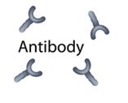
Label IT
The immune response…what is happening at each stage?

Slide 17
Label IT- Answers
White blood cells detect pathogens.
Antibodies are made and released into the blood much faster and in larger amounts.
Pathogens are destroyed by the antibodies much faster.

Slide 18
Get IT
Answer the questions
What is a pathogen?
What are bacteria?
What are viruses?
What is the difference between bacteria and viruses?
What is a vaccine?
Name two types of white blood cell.
How do white blood cells protect you from disease?
What does the word immunity mean?
What is the difference between communicable and non-communicable diseases?

Slide 19
Self assessment
Get IT-
Answers
What is a pathogen?
Microorganism that causes disease.
What are bacteria?
A single celled microorganism that has no nucleus. This causes disease by reproducing and producing toxins.
What are viruses?
Viruses are pathogens. Need to reproduce inside other cells, always damage cells
What is the difference between bacteria and viruses?
Viruses are much smaller than bacteria and viruses are not cells but bacteria are
What is a vaccine?
An injection of a dead or weakened version of the pathogen
Name two types of white blood cell.
Lymphocyte and phagocyte
How do white blood cells protect you from disease?
Lymphocyte release antibodies and phagocytes engulf and digest the pathogen
What does the word immunity mean?
When your already has the antibodies so that the pathogen does not harm you
What is the difference between communicable and non-communicable diseases?
Communicable diseases can be transmitted through contact and non communicable diseases cannot.

Slide 20
The PiXL Club The PiXL Club The PiXL Club The PiXL Club The PiXL Club The PiXL Club The PiXL Club The PiXL Club The PiXL Club The PiXL Club The PiXL Club The PiXL Club The PiXL Club The PiXL Club The PiXL Club The PiXL Club The PiXL Club The PiXL Club The PiXL Club The PiXL Club The PiXL Club The PiXL Club The PiXL Club The PiXL Club The PiXL Club The PiXL Club The PiXL Club The PiXL Club The PiXL Club The PiXL Club The PiXL Club The PiXL Club The PiXL Club The PiXL Club The PiXL Club The PiXL Club The PiXL Club The PiXL Club The PiXL Club The PiXL Club The PiXL Club The PiXL Club The PiXL Club The PiXL Club The PiXL Club XL Club The PiXL Club The PiXL Club The PiXL Club The PiXL Club The PiXL Club The PiXL Club The PiXL Club The PiXL Club The PiXL Club The PiXL Club The PiXL Club The PiXL Club The PiXL Club The PiXL Club The PiXL Club The PiXL Club The PiXL Club The PiXL Club The PiXL Club The PiXL Club The PiXL Club The PiXL Club The PiXL Club The PiXL Club The PiXL Club The PiXL Club The PiXL Club The PiXL Club The PiXL Club The PiXL Club The PiXL Club The PiXL Club The PiXL Club The PiXL Club The PiXL Club The PiXL Club The PiXL Club The PiXL Club The PiXL Club The PiXL Club The PiXL Club The PiXL Club The PiXL Club The PiXL Club The PiXL Club The PiXL Club The PiXL Club The PiXL Club The PiXL Club The PiXL Club The PiXL Club The PiXL Club The PiXL Club The PiXL Club The PiXL Club The PiXL Club The PiXL Club The PiXL Club The PiXL Club The PiXL Club The PiXL Club The PiXL Club The PiXL Club The PiXL Club The PiXL Club The PiXL Club The PiXL Club The PiXL Club The PiXL Club The PiXL Club The PiXL Club The PiXL Club The PiXL Club The PiXL Club The PiXL Club The PiXL Club The PiXL Club The PiXL Club The PiXL Club The PiXL Club The PiXL Club The PiXL Club The PiXL Club The PiXL Club The PiXL Club The PiXL Club The PiXL Club The PiXL Club The PiXL Club The PiXL Club The PiXL Club The PiXL Club The PiXL Club The PiXL Club The PiXL Club The PiXL Club The PiXL Club The PiXL Club The PiXL Club The PiXL Club The PiXL Club The PiXL Club The PiXL Club The PiXL Club The PiXL Club The PiXL Club The PiXL Club The PiXL Club The PiXL Club The PiXL Club The PiXL Club The PiXL Club The PiXL Club The PiXL Club The PiXL Club The PiXL Club The PiXL Club The PiXL Club The PiXL Club The PiXL Club The PiXL Club The PiXL Club The PiXL Club The PiXL Club The PiXL Club The PiXL Club The PiXL Club The PiXL Club The PiXL Club The PiXL Club The PiXL Club The PiXL Club The PiXL Club The PiXL Club The PiXL Club The PiXL Club The PiXL Club The PiXL Club The PiXL Club The PiXL Club The PiXL Club The PiXL Club The PiXL Club The PiXL Club The PiXL Club The PiXL Club The PiXL Club The PiXL Club The PiXL Club The PiXL Club The PiXL Club The PiXL Club The PiXL Club The PiXL Club The PiXL Club The PiXL Club The PiXL Club The PiXL Club The PiXL Club The PiXL Club The PiXL Club The PiXL Club The PiXL Club The PiXL Club The PiXL Club The PiXL Club The PiXL Club The PiXL Club The PiXL Club The PiXL Club The PiXL Club The PiXL Club The PiXL Club The PiXL Club The PiXL Club The PiXL Club The PiXL Club The PiXL Club The PiXL Club The PiXL Club The PiXL Club The PiXL Club The PiXL Club The PiXL Club The PiXL Club The PiXL Club The PiXL Club The PiXL Club The PiXL Club The PiXL Club The PiXL Club The PiXL Club The PiXL Club The PiXL Club The PiXL Club The PiXL Club The PiXL Club The PiXL Club The PiXL Club The PiXL Club The PiXL Club The PiXL Club The PiXL Club The PiXL Club The PiXL Club The PiXL Club The PiXL Club The PiXL Club The PiXL Club The PiXL Club The PiXL Club The PiXL Club The PiXL Club The PiXL Club The PiXL Club The PiXL Club The PiXL Club The PiXL Club The PiXL Club The PiXL Club The PiXL Club The PiXL Club The PiXL Club The PiXL Club The PiXL Club The PiXL Club The PiXL Club The PiXL Club The PiXL Club The PiXL Club The PiXL Club The PiXL Club The PiXL Club The PiXL Club The PiXL Club The PiXL Club The PiXL Club The PiXL Club The PiXL Club The PiXL Club The PiXL Club The PiXL Club The PiXL Club The PiXL Club The PiXL Club The PiXL Club The PiXL Club The PiXL Club The PiXL Club The PiXL Club The PiXL Club The PiXL Club The PiXL Club The PiXL Club The PiXL Club The PiXL Club The PiXL Club The PiXL Club The PiXL Club The PiXL Club The PiXL Club The PiXL Club The PiXL Club The PiXL Club The PiXL Club The PiXL Club The PiXL Club The PiXL Club The PiXL Club The PiXL Club The PiXL Club The PiXL Club The PiXL Club The PiXL Club The PiXL Club The PiXL Club The PiXL Club The PiXL Club The PiXL Club The PiXL Club The PiXL Club The PiXL Club The PiXL Club The PiXL Club The PiXL Club The PiXL Club The PiXL Club The PiXL Club The PiXL Club The PiXL Club The PiXL Club The PiXL Club The PiXL Club The PiXL Club The PiXL Club The PiXL Club The PiXL Club The PiXL Club The PiXL Club The PiXL Club The PiXL Club The PiXL Club The PiXL Club The PiXL Club The PiXL Club The PiXL Club The PiXL Club The PiXL Club The PiXL Club The PiXL Club The PiXL Club The PiXL Club The PiXL Club The PiXL Club The PiXL Club The PiXL Club The PiXL Club The PiXL Club The PiXL Club The PiXL Club The PiXL Club The PiXL Club The PiXL Club The PiXL Club The PiXL Club The PiXL Club The PiXL Club The PiXL Club The PiXL Club The PiXL Club The PiXL Club The PiXL Club The PiXL Club The PiXL Club The PiXL Club The PiXL Club The PiXL Club The PiXL Club The PiXL Club The PiXL Club The PiXL Club The PiXL Club The PiXL Club The PiXL Club The PiXL Club The PiXL Club The PiXL Club The PiXL Club The PiXL Club The PiXL Club The PiXL Club The PiXL Club The PiXL Club The PiXL Club The PiXL Club The PiXL Club The PiXL Club The PiXL Club The PiXL Club The PiXL Club The PiXL Club The PiXL Club The PiXL Club The PiXL Club The PiXL Club The PiXL Club The PiXL Club The PiXL Club The PiXL Club The PiXL Club The PiXL Club The PiXL Club The PiXL Club The PiXL Club The PiXL Club The PiXL Club The PiXL Club The PiXL Club The PiXL Club The PiXL Club The PiXL Club The PiXL Club The PiXL Club The PiXL Club The PiXL Club The PiXL Club The PiXL Club The PiXL Club The PiXL Club The PiXL Club The PiXL Club The PiXL Club The PiXL Club The PiXL Club The PiXL Club The PiXL Club The PiXL Club The PiXL Club The PiXL Club The PiXL Club The PiXL Club The PiXL Club The PiXL Club The PiXL Club The PiXL Club The PiXL Club The PiXL Club The PiXL Club The PiXL Club The PiXL Club The PiXL Club The PiXL Club The PiXL Club The PiXL Club The PiXL Club The PiXL Club The PiXL Club The PiXL Club The PiXL Club The PiXL Club The PiXL Club The PiXL Club The PiXL Club The PiXL Club The PiXL Club The PiXL Club The PiXL Club The PiXL Club The PiXL Club The PiXL Club The PiXL Club The PiXL Club The PiXL Club The PiXL Club The PiXL Club The PiXL Club The PiXL Club The PiXL Club The PiXL Club The PiXL Club The PiXL Club The PiXL Club The PiXL Club The PiXL Club The PiXL Club The PiXL Club The PiXL Club The PiXL Club The PiXL Club The PiXL Club The PiXL Club The PiXL Club The PiXL Club The PiXL Club The PiXL Club The PiXL Club The PiXL Club The PiXL Club The PiXL Club The PiXL Club The PiXL Club The PiXL Club The PiXL Club The PiXL Club The PiXL Club The PiXL Club The PiXL Club The PiXL Club The PiXL Club The PiXL Club The PiXL Club The PiXL Club The PiXL Club The PiXL Club The PiXL Club The PiXL Club The PiXL Club The PiXL Club The PiXL Club The PiXL Club The PiXL Club The PiXL Club The PiXL Club The PiXL Club The PiXL Club The PiXL Club The PiXL Club The PiXL Club The PiXL Club The PiXL Club The PiXL Club The PiXL Club The PiXL Club The PiXL Club The PiXL Club The PiXL Club The PiXL Club The PiXL Club The PiXL Club The PiXL Club The PiXL Club The PiXL Club The PiXL Club The PiXL Club The PiXL Club The PiXL Club The PiXL Club The PiXL Club The PiXL Club The PiXL Club The PiXL Club The PiXL Club The PiXL Club The PiXL Club The PiXL Club The PiXL Club The PiXL Club The PiXL Club The PiXL Club The PiXL Club The PiXL Club The PiXL Club The PiXL Club The PiXL Club The PiXL Club The PiXL Club The PiXL Club The PiXL Club The PiXL Club The PiXL Club The PiXL Club The PiXL Club The PiXL Club The PiXL Club The PiXL Club The PiXL Club The PiXL Club The PiXL Club The PiXL Club The PiXL Club The PiXL Club The PiXL Club The PiXL Club The PiXL Club The PiXL Club The PiXL Club The PiXL Club The PiXL Club The PiXL Club The PiXL Club The PiXL Club The PiXL Club The PiXL Club The PiXL Club The PiXL Club The PiXL Club The PiXL Club The PiXL Club The PiXL Club The PiXL Club The PiXL Club The PiXL Club The PiXL Club The PiXL Club The PiXL Club The PiXL Club The PiXL Club The PiXL Club The PiXL Club The PiXL Club The PiXL Club The PiXL Club The PiXL Club The PiXL Club The PiXL Club The PiXL Club The PiXL Club The PiXL Club The PiXL Club The PiXL Club The PiXL Club The PiXL Club The PiXL Club The PiXL Club The PiXL Club The PiXL Club The PiXL Club The PiXL Club The PiXL Club The PiXL Club The PiXL Club The PiXL Club The PiXL Club The PiXL Club The PiXL Club The PiXL Club The PiXL Club The PiXL Club The PiXL Club The PiXL Club The PiXL Club The PiXL Club The PiXL Club The PiXL Club The PiXL Club The PiXL Club The PiXL Club The PiXL Club The PiXL Club The PiXL Club The PiXL Club The PiXL Club The PiXL Club The PiXL Club The PiXL Club The PiXL Club The PiXL Club The PiXL Club The PiXL Club The PiXL Club The PiXL Club The PiXL Club The PiXL Club The PiXL Club The PiXL Club The PiXL Club The PiXL Club The PiXL Club The PiXL Club The PiXL Club The PiXL Club The PiXL Club The PiXL Club The PiXL Club The PiXL Club The PiXL Club The PiXL Club The PiXL Club The PiXL Club The PiXL Club The PiXL Club The PiXL Club The PiXL Club The PiXL Club The PiXL Club The PiXL Club The PiXL Club The PiXL Club The PiXL Club The PiXL Club The PiXL Club The PiXL Club The PiXL Club The PiXL Club The PiXL Club The PiXL Club The PiXL Club The PiXL Club The PiXL Club The PiXL Club The PiXL Club The PiXL Club The PiXL Club The PiXL Club The PiXL Club The PiXL Club The PiXL Club The PiXL Club The PiXL Club The PiXL Club The PiXL Club The PiXL Club The PiXL Club The PiXL Club The PiXL Club The PiXL Club The PiXL Club The PiXL Club The PiXL Club The PiXL Club The PiXL Club The PiXL Club The PiXL Club The PiXL Club The PiXL Club The PiXL Club The PiXL Club The PiXL Club The PiXL Club The PiXL Club The PiXL Club The PiXL Club The PiXL Club The PiXL Club The PiXL Club The PiXL Club The PiXL Club The PiXL Club The PiXL Club The PiXL Club
PiXL GetIT!
GCSE Chemistry
Topic – Atomic Structure
© Copyright The PiXL Club Ltd, 2017
This resource is strictly for the use of member schools for as long as they remain members of The PiXL Club. It may not be copied, sold nor transferred to a third party or used by the school after membership ceases. Until such time it may be freely used within the member school.
All opinions and contributions are those of the authors. The contents of this resource are not connected with nor endorsed by any other company, organisation or institution.
www.pixl.org.uk The PiXL Club Ltd, Company number 07321607

Slide 21
GetIT – Atomic Structure
All substances are made of atoms, that cannot chemically be broken down.
Sub = under or beneath atomic = relating to atoms
Subatomic particles
These are found inside an atom; they are beneath (or inside) the atom structure.

Slide 22
Match IT
Atom |  | Positively charged subatomic particle
Ion |  | Formed from two or more elements by chemical reactions
Isotope |  | A substance which cannot be broken down chemically
Neutron |  | A charged particle
Proton |  | The smallest part of an element
Electron |  | Atom of an element with a different number of neutrons
Nucleus |  | Negatively charged subatomic particle
Element |  | Part of atom which contains neutrons and protons
Compound |  | Subatomic particle with no charge

Slide 23
Match IT - Answers
Atom |  | The smallest part of an element
Ion |  | A charged particle
Isotope |  | Atom of an element with a different number of neutrons
Neutron |  | Subatomic particle with no charge
Proton |  | Positively charged subatomic particle
Electron |  | Negatively charged subatomic particle
Nucleus |  | Part of atom which contains neutrons and protons
Element |  | A substance which cannot be broken down chemically
Compound |  | Formed from two or more elements by chemical reactions

Slide 24
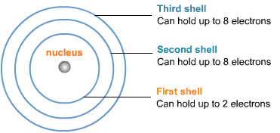
Electron configuration
TEACH IT

Slide 25
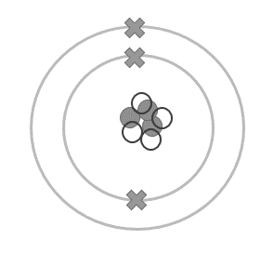
Label IT
Label the diagram.
Using the periodic table to help you, write as much information about this atom as you can.

Slide 26
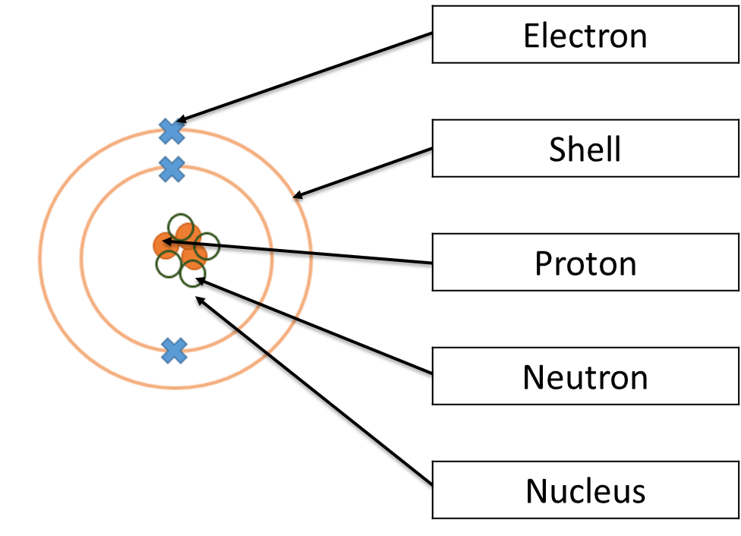
Label IT - Answers
3 electrons
3 protons
4 neutrons
2 shells
Lithium
Group 1
Period 2
Atomic number 3
Mass number 7

Slide 27
The PiXL Club The PiXL Club The PiXL Club The PiXL Club The PiXL Club The PiXL Club The PiXL Club The PiXL Club The PiXL Club The PiXL Club The PiXL Club The PiXL Club The PiXL Club The PiXL Club The PiXL Club The PiXL Club The PiXL Club The PiXL Club The PiXL Club The PiXL Club The PiXL Club The PiXL Club The PiXL Club The PiXL Club The PiXL Club The PiXL Club The PiXL Club The PiXL Club The PiXL Club The PiXL Club The PiXL Club The PiXL Club The PiXL Club The PiXL Club The PiXL Club The PiXL Club The PiXL Club The PiXL Club The PiXL Club The PiXL Club The PiXL Club The PiXL Club The PiXL Club The PiXL Club The PiXL Club XL Club The PiXL Club The PiXL Club The PiXL Club The PiXL Club The PiXL Club The PiXL Club The PiXL Club The PiXL Club The PiXL Club The PiXL Club The PiXL Club The PiXL Club The PiXL Club The PiXL Club The PiXL Club The PiXL Club The PiXL Club The PiXL Club The PiXL Club The PiXL Club The PiXL Club The PiXL Club The PiXL Club The PiXL Club The PiXL Club The PiXL Club The PiXL Club The PiXL Club The PiXL Club The PiXL Club The PiXL Club The PiXL Club The PiXL Club The PiXL Club The PiXL Club The PiXL Club The PiXL Club The PiXL Club The PiXL Club The PiXL Club The PiXL Club The PiXL Club The PiXL Club The PiXL Club The PiXL Club The PiXL Club The PiXL Club The PiXL Club The PiXL Club The PiXL Club The PiXL Club The PiXL Club The PiXL Club The PiXL Club The PiXL Club The PiXL Club The PiXL Club The PiXL Club The PiXL Club The PiXL Club The PiXL Club The PiXL Club The PiXL Club The PiXL Club The PiXL Club The PiXL Club The PiXL Club The PiXL Club The PiXL Club The PiXL Club The PiXL Club The PiXL Club The PiXL Club The PiXL Club The PiXL Club The PiXL Club The PiXL Club The PiXL Club The PiXL Club The PiXL Club The PiXL Club The PiXL Club The PiXL Club The PiXL Club The PiXL Club The PiXL Club The PiXL Club The PiXL Club The PiXL Club The PiXL Club The PiXL Club The PiXL Club The PiXL Club The PiXL Club The PiXL Club The PiXL Club The PiXL Club The PiXL Club The PiXL Club The PiXL Club The PiXL Club The PiXL Club The PiXL Club The PiXL Club The PiXL Club The PiXL Club The PiXL Club The PiXL Club The PiXL Club The PiXL Club The PiXL Club The PiXL Club The PiXL Club The PiXL Club The PiXL Club The PiXL Club The PiXL Club The PiXL Club The PiXL Club The PiXL Club The PiXL Club The PiXL Club The PiXL Club The PiXL Club The PiXL Club The PiXL Club The PiXL Club The PiXL Club The PiXL Club The PiXL Club The PiXL Club The PiXL Club The PiXL Club The PiXL Club The PiXL Club The PiXL Club The PiXL Club The PiXL Club The PiXL Club The PiXL Club The PiXL Club The PiXL Club The PiXL Club The PiXL Club The PiXL Club The PiXL Club The PiXL Club The PiXL Club The PiXL Club The PiXL Club The PiXL Club The PiXL Club The PiXL Club The PiXL Club The PiXL Club The PiXL Club The PiXL Club The PiXL Club The PiXL Club The PiXL Club The PiXL Club The PiXL Club The PiXL Club The PiXL Club The PiXL Club The PiXL Club The PiXL Club The PiXL Club The PiXL Club The PiXL Club The PiXL Club The PiXL Club The PiXL Club The PiXL Club The PiXL Club The PiXL Club The PiXL Club The PiXL Club The PiXL Club The PiXL Club The PiXL Club The PiXL Club The PiXL Club The PiXL Club The PiXL Club The PiXL Club The PiXL Club The PiXL Club The PiXL Club The PiXL Club The PiXL Club The PiXL Club The PiXL Club The PiXL Club The PiXL Club The PiXL Club The PiXL Club The PiXL Club The PiXL Club The PiXL Club The PiXL Club The PiXL Club The PiXL Club The PiXL Club The PiXL Club The PiXL Club The PiXL Club The PiXL Club The PiXL Club The PiXL Club The PiXL Club The PiXL Club The PiXL Club The PiXL Club The PiXL Club The PiXL Club The PiXL Club The PiXL Club The PiXL Club The PiXL Club The PiXL Club The PiXL Club The PiXL Club The PiXL Club The PiXL Club The PiXL Club The PiXL Club The PiXL Club The PiXL Club The PiXL Club The PiXL Club The PiXL Club The PiXL Club The PiXL Club The PiXL Club The PiXL Club The PiXL Club The PiXL Club The PiXL Club The PiXL Club The PiXL Club The PiXL Club The PiXL Club The PiXL Club The PiXL Club The PiXL Club The PiXL Club The PiXL Club The PiXL Club The PiXL Club The PiXL Club The PiXL Club The PiXL Club The PiXL Club The PiXL Club The PiXL Club The PiXL Club The PiXL Club The PiXL Club The PiXL Club The PiXL Club The PiXL Club The PiXL Club The PiXL Club The PiXL Club The PiXL Club The PiXL Club The PiXL Club The PiXL Club The PiXL Club The PiXL Club The PiXL Club The PiXL Club The PiXL Club The PiXL Club The PiXL Club The PiXL Club The PiXL Club The PiXL Club The PiXL Club The PiXL Club The PiXL Club The PiXL Club The PiXL Club The PiXL Club The PiXL Club The PiXL Club The PiXL Club The PiXL Club The PiXL Club The PiXL Club The PiXL Club The PiXL Club The PiXL Club The PiXL Club The PiXL Club The PiXL Club The PiXL Club The PiXL Club The PiXL Club The PiXL Club The PiXL Club The PiXL Club The PiXL Club The PiXL Club The PiXL Club The PiXL Club The PiXL Club The PiXL Club The PiXL Club The PiXL Club The PiXL Club The PiXL Club The PiXL Club The PiXL Club The PiXL Club The PiXL Club The PiXL Club The PiXL Club The PiXL Club The PiXL Club The PiXL Club The PiXL Club The PiXL Club The PiXL Club The PiXL Club The PiXL Club The PiXL Club The PiXL Club The PiXL Club The PiXL Club The PiXL Club The PiXL Club The PiXL Club The PiXL Club The PiXL Club The PiXL Club The PiXL Club The PiXL Club The PiXL Club The PiXL Club The PiXL Club The PiXL Club The PiXL Club The PiXL Club The PiXL Club The PiXL Club The PiXL Club The PiXL Club The PiXL Club The PiXL Club The PiXL Club The PiXL Club The PiXL Club The PiXL Club The PiXL Club The PiXL Club The PiXL Club The PiXL Club The PiXL Club The PiXL Club The PiXL Club The PiXL Club The PiXL Club The PiXL Club The PiXL Club The PiXL Club The PiXL Club The PiXL Club The PiXL Club The PiXL Club The PiXL Club The PiXL Club The PiXL Club The PiXL Club The PiXL Club The PiXL Club The PiXL Club The PiXL Club The PiXL Club The PiXL Club The PiXL Club The PiXL Club The PiXL Club The PiXL Club The PiXL Club The PiXL Club The PiXL Club The PiXL Club The PiXL Club The PiXL Club The PiXL Club The PiXL Club The PiXL Club The PiXL Club The PiXL Club The PiXL Club The PiXL Club The PiXL Club The PiXL Club The PiXL Club The PiXL Club The PiXL Club The PiXL Club The PiXL Club The PiXL Club The PiXL Club The PiXL Club The PiXL Club The PiXL Club The PiXL Club The PiXL Club The PiXL Club The PiXL Club The PiXL Club The PiXL Club The PiXL Club The PiXL Club The PiXL Club The PiXL Club The PiXL Club The PiXL Club The PiXL Club The PiXL Club The PiXL Club The PiXL Club The PiXL Club The PiXL Club The PiXL Club The PiXL Club The PiXL Club The PiXL Club The PiXL Club The PiXL Club The PiXL Club The PiXL Club The PiXL Club The PiXL Club The PiXL Club The PiXL Club The PiXL Club The PiXL Club The PiXL Club The PiXL Club The PiXL Club The PiXL Club The PiXL Club The PiXL Club The PiXL Club The PiXL Club The PiXL Club The PiXL Club The PiXL Club The PiXL Club The PiXL Club The PiXL Club The PiXL Club The PiXL Club The PiXL Club The PiXL Club The PiXL Club The PiXL Club The PiXL Club The PiXL Club The PiXL Club The PiXL Club The PiXL Club The PiXL Club The PiXL Club The PiXL Club The PiXL Club The PiXL Club The PiXL Club The PiXL Club The PiXL Club The PiXL Club The PiXL Club The PiXL Club The PiXL Club The PiXL Club The PiXL Club The PiXL Club The PiXL Club The PiXL Club The PiXL Club The PiXL Club The PiXL Club The PiXL Club The PiXL Club The PiXL Club The PiXL Club The PiXL Club The PiXL Club The PiXL Club The PiXL Club The PiXL Club The PiXL Club The PiXL Club The PiXL Club The PiXL Club The PiXL Club The PiXL Club The PiXL Club The PiXL Club The PiXL Club The PiXL Club The PiXL Club The PiXL Club The PiXL Club The PiXL Club The PiXL Club The PiXL Club The PiXL Club The PiXL Club The PiXL Club The PiXL Club The PiXL Club The PiXL Club The PiXL Club The PiXL Club The PiXL Club The PiXL Club The PiXL Club The PiXL Club The PiXL Club The PiXL Club The PiXL Club The PiXL Club The PiXL Club The PiXL Club The PiXL Club The PiXL Club The PiXL Club The PiXL Club The PiXL Club The PiXL Club The PiXL Club The PiXL Club The PiXL Club The PiXL Club The PiXL Club The PiXL Club The PiXL Club The PiXL Club The PiXL Club The PiXL Club The PiXL Club The PiXL Club The PiXL Club The PiXL Club The PiXL Club The PiXL Club The PiXL Club The PiXL Club The PiXL Club The PiXL Club The PiXL Club The PiXL Club The PiXL Club The PiXL Club The PiXL Club The PiXL Club The PiXL Club The PiXL Club The PiXL Club The PiXL Club The PiXL Club The PiXL Club The PiXL Club The PiXL Club The PiXL Club The PiXL Club The PiXL Club The PiXL Club The PiXL Club The PiXL Club The PiXL Club The PiXL Club The PiXL Club The PiXL Club The PiXL Club The PiXL Club The PiXL Club The PiXL Club The PiXL Club The PiXL Club The PiXL Club The PiXL Club The PiXL Club The PiXL Club The PiXL Club The PiXL Club The PiXL Club The PiXL Club The PiXL Club The PiXL Club The PiXL Club The PiXL Club The PiXL Club The PiXL Club The PiXL Club The PiXL Club The PiXL Club The PiXL Club The PiXL Club The PiXL Club The PiXL Club The PiXL Club The PiXL Club The PiXL Club The PiXL Club The PiXL Club The PiXL Club The PiXL Club The PiXL Club The PiXL Club The PiXL Club The PiXL Club The PiXL Club The PiXL Club The PiXL Club The PiXL Club The PiXL Club The PiXL Club The PiXL Club The PiXL Club The PiXL Club The PiXL Club The PiXL Club The PiXL Club The PiXL Club The PiXL Club The PiXL Club The PiXL Club The PiXL Club The PiXL Club The PiXL Club The PiXL Club The PiXL Club The PiXL Club The PiXL Club The PiXL Club The PiXL Club The PiXL Club The PiXL Club The PiXL Club The PiXL Club The PiXL Club The PiXL Club The PiXL Club The PiXL Club The PiXL Club The PiXL Club The PiXL Club The PiXL Club The PiXL Club The PiXL Club The PiXL Club The PiXL Club The PiXL Club The PiXL Club The PiXL Club The PiXL Club The PiXL Club The PiXL Club The PiXL Club The PiXL Club The PiXL Club The PiXL Club The PiXL Club The PiXL Club The PiXL Club The PiXL Club The PiXL Club The PiXL Club The PiXL Club The PiXL Club The PiXL Club The PiXL Club The PiXL Club The PiXL Club The PiXL Club The PiXL Club The PiXL Club The PiXL Club The PiXL Club The PiXL Club The PiXL Club The PiXL Club The PiXL Club The PiXL Club The PiXL Club The PiXL Club The PiXL Club The PiXL Club The PiXL Club The PiXL Club The PiXL Club The PiXL Club The PiXL Club
PiXL GetIT!
GCSE Chemistry
Topic – Periodic table and elements
© Copyright The PiXL Club Ltd, 2017
This resource is strictly for the use of member schools for as long as they remain members of The PiXL Club. It may not be copied, sold nor transferred to a third party or used by the school after membership ceases. Until such time it may be freely used within the member school.
All opinions and contributions are those of the authors. The contents of this resource are not connected with nor endorsed by any other company, organisation or institution.
www.pixl.org.uk The PiXL Club Ltd, Company number 07321607

Slide 28
GetIT – Periodic table and elements
The Periodic table contains all the known elements.
A group in the Periodic table is a column.
A period in the Periodic table is a row.
Alkali metals = make an alkaline solution in water.
Halogens = react with metals to make salts.
Hal = salt gen = to make
Noble gases = are unreactive.

Slide 29
Match IT
Element |  | The rows in the Periodic table
Isotope |  | Elements in group 0 of the Periodic table
Group |  | Made up of only one type of atom
Period |  | Number of protons in an atom
Alkali metal |  | Elements in group 7 of the Periodic table
Noble gas |  | The columns in the Periodic table
Halogen |  | Number of protons + neutrons in an atom
Atomic number |  | Atoms that have the same number of protons but different numbers of neutrons
Atomic mass |  | Elements in group 1 of the Periodic table

Slide 30
Match IT - Answers
Element |  | Made up of only one type of atom
Isotope |  | Atoms that have the same number of protons but different numbers of neutrons
Group |  | The columns in the Periodic table
Period |  | The rows in the Periodic table
Alkali metal |  | Elements in group 1 of the Periodic table
Noble gas |  | Elements in group 0 of the Periodic table
Halogen |  | Elements in group 7 of the Periodic table
Atomic number |  | Number of protons in an atom
Atomic mass |  | Number of protons + neutrons in an atom

Slide 31
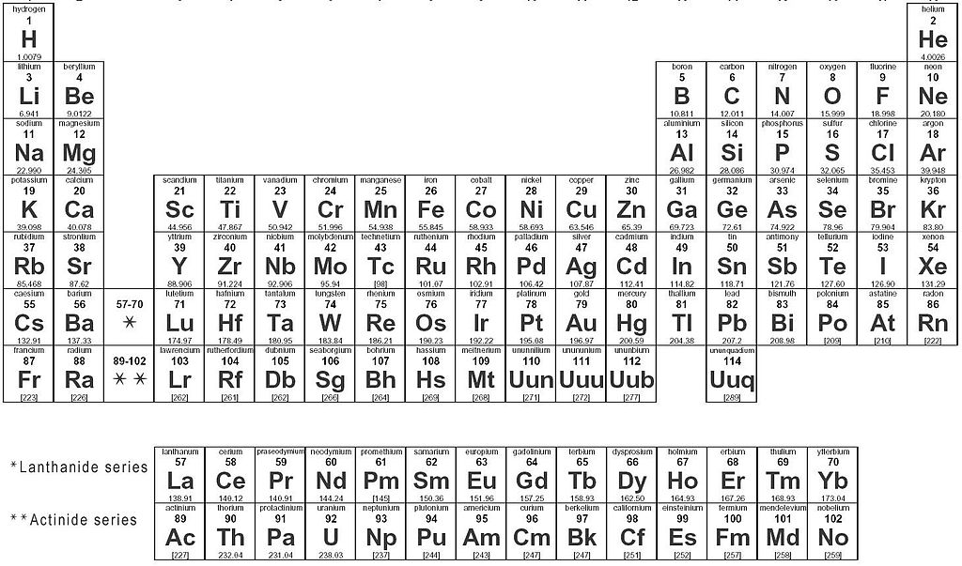
Label IT

Slide 32
Label IT - Answers
Alkali metal
Group
Period
Halogen
Noble gas

Slide 33
Label IT
6
C
12
6
C
13

Slide 34
Label IT - Answers
Number of protons
Atomic number
Atomic mass
Isotopes
6
C
12
6
C
13
Number of protons + neutrons
Same number of protons, different number of neutrons.

Slide 35
The PiXL Club The PiXL Club The PiXL Club The PiXL Club The PiXL Club The PiXL Club The PiXL Club The PiXL Club The PiXL Club The PiXL Club The PiXL Club The PiXL Club The PiXL Club The PiXL Club The PiXL Club The PiXL Club The PiXL Club The PiXL Club The PiXL Club The PiXL Club The PiXL Club The PiXL Club The PiXL Club The PiXL Club The PiXL Club The PiXL Club The PiXL Club The PiXL Club The PiXL Club The PiXL Club The PiXL Club The PiXL Club The PiXL Club The PiXL Club The PiXL Club The PiXL Club The PiXL Club The PiXL Club The PiXL Club The PiXL Club The PiXL Club The PiXL Club The PiXL Club The PiXL Club The PiXL Club XL Club The PiXL Club The PiXL Club The PiXL Club The PiXL Club The PiXL Club The PiXL Club The PiXL Club The PiXL Club The PiXL Club The PiXL Club The PiXL Club The PiXL Club The PiXL Club The PiXL Club The PiXL Club The PiXL Club The PiXL Club The PiXL Club The PiXL Club The PiXL Club The PiXL Club The PiXL Club The PiXL Club The PiXL Club The PiXL Club The PiXL Club The PiXL Club The PiXL Club The PiXL Club The PiXL Club The PiXL Club The PiXL Club The PiXL Club The PiXL Club The PiXL Club The PiXL Club The PiXL Club The PiXL Club The PiXL Club The PiXL Club The PiXL Club The PiXL Club The PiXL Club The PiXL Club The PiXL Club The PiXL Club The PiXL Club The PiXL Club The PiXL Club The PiXL Club The PiXL Club The PiXL Club The PiXL Club The PiXL Club The PiXL Club The PiXL Club The PiXL Club The PiXL Club The PiXL Club The PiXL Club The PiXL Club The PiXL Club The PiXL Club The PiXL Club The PiXL Club The PiXL Club The PiXL Club The PiXL Club The PiXL Club The PiXL Club The PiXL Club The PiXL Club The PiXL Club The PiXL Club The PiXL Club The PiXL Club The PiXL Club The PiXL Club The PiXL Club The PiXL Club The PiXL Club The PiXL Club The PiXL Club The PiXL Club The PiXL Club The PiXL Club The PiXL Club The PiXL Club The PiXL Club The PiXL Club The PiXL Club The PiXL Club The PiXL Club The PiXL Club The PiXL Club The PiXL Club The PiXL Club The PiXL Club The PiXL Club The PiXL Club The PiXL Club The PiXL Club The PiXL Club The PiXL Club The PiXL Club The PiXL Club The PiXL Club The PiXL Club The PiXL Club The PiXL Club The PiXL Club The PiXL Club The PiXL Club The PiXL Club The PiXL Club The PiXL Club The PiXL Club The PiXL Club The PiXL Club The PiXL Club The PiXL Club The PiXL Club The PiXL Club The PiXL Club The PiXL Club The PiXL Club The PiXL Club The PiXL Club The PiXL Club The PiXL Club The PiXL Club The PiXL Club The PiXL Club The PiXL Club The PiXL Club The PiXL Club The PiXL Club The PiXL Club The PiXL Club The PiXL Club The PiXL Club The PiXL Club The PiXL Club The PiXL Club The PiXL Club The PiXL Club The PiXL Club The PiXL Club The PiXL Club The PiXL Club The PiXL Club The PiXL Club The PiXL Club The PiXL Club The PiXL Club The PiXL Club The PiXL Club The PiXL Club The PiXL Club The PiXL Club The PiXL Club The PiXL Club The PiXL Club The PiXL Club The PiXL Club The PiXL Club The PiXL Club The PiXL Club The PiXL Club The PiXL Club The PiXL Club The PiXL Club The PiXL Club The PiXL Club The PiXL Club The PiXL Club The PiXL Club The PiXL Club The PiXL Club The PiXL Club The PiXL Club The PiXL Club The PiXL Club The PiXL Club The PiXL Club The PiXL Club The PiXL Club The PiXL Club The PiXL Club The PiXL Club The PiXL Club The PiXL Club The PiXL Club The PiXL Club The PiXL Club The PiXL Club The PiXL Club The PiXL Club The PiXL Club The PiXL Club The PiXL Club The PiXL Club The PiXL Club The PiXL Club The PiXL Club The PiXL Club The PiXL Club The PiXL Club The PiXL Club The PiXL Club The PiXL Club The PiXL Club The PiXL Club The PiXL Club The PiXL Club The PiXL Club The PiXL Club The PiXL Club The PiXL Club The PiXL Club The PiXL Club The PiXL Club The PiXL Club The PiXL Club The PiXL Club The PiXL Club The PiXL Club The PiXL Club The PiXL Club The PiXL Club The PiXL Club The PiXL Club The PiXL Club The PiXL Club The PiXL Club The PiXL Club The PiXL Club The PiXL Club The PiXL Club The PiXL Club The PiXL Club The PiXL Club The PiXL Club The PiXL Club The PiXL Club The PiXL Club The PiXL Club The PiXL Club The PiXL Club The PiXL Club The PiXL Club The PiXL Club The PiXL Club The PiXL Club The PiXL Club The PiXL Club The PiXL Club The PiXL Club The PiXL Club The PiXL Club The PiXL Club The PiXL Club The PiXL Club The PiXL Club The PiXL Club The PiXL Club The PiXL Club The PiXL Club The PiXL Club The PiXL Club The PiXL Club The PiXL Club The PiXL Club The PiXL Club The PiXL Club The PiXL Club The PiXL Club The PiXL Club The PiXL Club The PiXL Club The PiXL Club The PiXL Club The PiXL Club The PiXL Club The PiXL Club The PiXL Club The PiXL Club The PiXL Club The PiXL Club The PiXL Club The PiXL Club The PiXL Club The PiXL Club The PiXL Club The PiXL Club The PiXL Club The PiXL Club The PiXL Club The PiXL Club The PiXL Club The PiXL Club The PiXL Club The PiXL Club The PiXL Club The PiXL Club The PiXL Club The PiXL Club The PiXL Club The PiXL Club The PiXL Club The PiXL Club The PiXL Club The PiXL Club The PiXL Club The PiXL Club The PiXL Club The PiXL Club The PiXL Club The PiXL Club The PiXL Club The PiXL Club The PiXL Club The PiXL Club The PiXL Club The PiXL Club The PiXL Club The PiXL Club The PiXL Club The PiXL Club The PiXL Club The PiXL Club The PiXL Club The PiXL Club The PiXL Club The PiXL Club The PiXL Club The PiXL Club The PiXL Club The PiXL Club The PiXL Club The PiXL Club The PiXL Club The PiXL Club The PiXL Club The PiXL Club The PiXL Club The PiXL Club The PiXL Club The PiXL Club The PiXL Club The PiXL Club The PiXL Club The PiXL Club The PiXL Club The PiXL Club The PiXL Club The PiXL Club The PiXL Club The PiXL Club The PiXL Club The PiXL Club The PiXL Club The PiXL Club The PiXL Club The PiXL Club The PiXL Club The PiXL Club The PiXL Club The PiXL Club The PiXL Club The PiXL Club The PiXL Club The PiXL Club The PiXL Club The PiXL Club The PiXL Club The PiXL Club The PiXL Club The PiXL Club The PiXL Club The PiXL Club The PiXL Club The PiXL Club The PiXL Club The PiXL Club The PiXL Club The PiXL Club The PiXL Club The PiXL Club The PiXL Club The PiXL Club The PiXL Club The PiXL Club The PiXL Club The PiXL Club The PiXL Club The PiXL Club The PiXL Club The PiXL Club The PiXL Club The PiXL Club The PiXL Club The PiXL Club The PiXL Club The PiXL Club The PiXL Club The PiXL Club The PiXL Club The PiXL Club The PiXL Club The PiXL Club The PiXL Club The PiXL Club The PiXL Club The PiXL Club The PiXL Club The PiXL Club The PiXL Club The PiXL Club The PiXL Club The PiXL Club The PiXL Club The PiXL Club The PiXL Club The PiXL Club The PiXL Club The PiXL Club The PiXL Club The PiXL Club The PiXL Club The PiXL Club The PiXL Club The PiXL Club The PiXL Club The PiXL Club The PiXL Club The PiXL Club The PiXL Club The PiXL Club The PiXL Club The PiXL Club The PiXL Club The PiXL Club The PiXL Club The PiXL Club The PiXL Club The PiXL Club The PiXL Club The PiXL Club The PiXL Club The PiXL Club The PiXL Club The PiXL Club The PiXL Club The PiXL Club The PiXL Club The PiXL Club The PiXL Club The PiXL Club The PiXL Club The PiXL Club The PiXL Club The PiXL Club The PiXL Club The PiXL Club The PiXL Club The PiXL Club The PiXL Club The PiXL Club The PiXL Club The PiXL Club The PiXL Club The PiXL Club The PiXL Club The PiXL Club The PiXL Club The PiXL Club The PiXL Club The PiXL Club The PiXL Club The PiXL Club The PiXL Club The PiXL Club The PiXL Club The PiXL Club The PiXL Club The PiXL Club The PiXL Club The PiXL Club The PiXL Club The PiXL Club The PiXL Club The PiXL Club The PiXL Club The PiXL Club The PiXL Club The PiXL Club The PiXL Club The PiXL Club The PiXL Club The PiXL Club The PiXL Club The PiXL Club The PiXL Club The PiXL Club The PiXL Club The PiXL Club The PiXL Club The PiXL Club The PiXL Club The PiXL Club The PiXL Club The PiXL Club The PiXL Club The PiXL Club The PiXL Club The PiXL Club The PiXL Club The PiXL Club The PiXL Club The PiXL Club The PiXL Club The PiXL Club The PiXL Club The PiXL Club The PiXL Club The PiXL Club The PiXL Club The PiXL Club The PiXL Club The PiXL Club The PiXL Club The PiXL Club The PiXL Club The PiXL Club The PiXL Club The PiXL Club The PiXL Club The PiXL Club The PiXL Club The PiXL Club The PiXL Club The PiXL Club The PiXL Club The PiXL Club The PiXL Club The PiXL Club The PiXL Club The PiXL Club The PiXL Club The PiXL Club The PiXL Club The PiXL Club The PiXL Club The PiXL Club The PiXL Club The PiXL Club The PiXL Club The PiXL Club The PiXL Club The PiXL Club The PiXL Club The PiXL Club The PiXL Club The PiXL Club The PiXL Club The PiXL Club The PiXL Club The PiXL Club The PiXL Club The PiXL Club The PiXL Club The PiXL Club The PiXL Club The PiXL Club The PiXL Club The PiXL Club The PiXL Club The PiXL Club The PiXL Club The PiXL Club The PiXL Club The PiXL Club The PiXL Club The PiXL Club The PiXL Club The PiXL Club The PiXL Club The PiXL Club The PiXL Club The PiXL Club The PiXL Club The PiXL Club The PiXL Club The PiXL Club The PiXL Club The PiXL Club The PiXL Club The PiXL Club The PiXL Club The PiXL Club The PiXL Club The PiXL Club The PiXL Club The PiXL Club The PiXL Club The PiXL Club The PiXL Club The PiXL Club The PiXL Club The PiXL Club The PiXL Club The PiXL Club The PiXL Club The PiXL Club The PiXL Club The PiXL Club The PiXL Club The PiXL Club The PiXL Club The PiXL Club The PiXL Club The PiXL Club The PiXL Club The PiXL Club The PiXL Club The PiXL Club The PiXL Club The PiXL Club The PiXL Club The PiXL Club The PiXL Club The PiXL Club The PiXL Club The PiXL Club The PiXL Club The PiXL Club The PiXL Club The PiXL Club The PiXL Club The PiXL Club The PiXL Club The PiXL Club The PiXL Club The PiXL Club The PiXL Club The PiXL Club The PiXL Club The PiXL Club The PiXL Club The PiXL Club The PiXL Club The PiXL Club The PiXL Club The PiXL Club The PiXL Club The PiXL Club The PiXL Club The PiXL Club The PiXL Club The PiXL Club The PiXL Club The PiXL Club The PiXL Club The PiXL Club The PiXL Club The PiXL Club The PiXL Club The PiXL Club The PiXL Club The PiXL Club The PiXL Club The PiXL Club The PiXL Club The PiXL Club The PiXL Club The PiXL Club The PiXL Club The PiXL Club The PiXL Club The PiXL Club The PiXL Club The PiXL Club The PiXL Club The PiXL Club The PiXL Club The PiXL Club The PiXL Club The PiXL Club The PiXL Club The PiXL Club The PiXL Club The PiXL Club The PiXL Club The PiXL Club The PiXL Club The PiXL Club The PiXL Club The PiXL Club The PiXL Club
PiXL GetIT!
GCSE Physics
Topic – Electricity
© Copyright The PiXL Club Ltd, 2017
This resource is strictly for the use of member schools for as long as they remain members of The PiXL Club. It may not be copied, sold nor transferred to a third party or used by the school after membership ceases. Until such time it may be freely used within the member school.
All opinions and contributions are those of the authors. The contents of this resource are not connected with nor endorsed by any other company, organisation or institution.
www.pixl.org.uk The PiXL Club Ltd, Company number 07321607

Slide 36
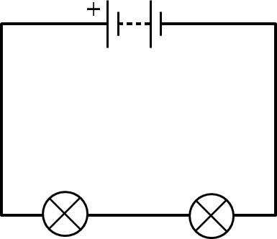
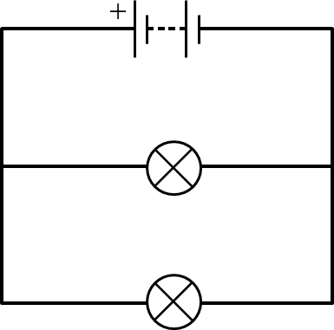
GetIT – Electricity
Electric current is a flow of charge through a conductor.
Current is not used up in a circuit.
Some components resist the flow of electrons more than others and have a greater resistance.
Series circuit
Parallel circuit

Slide 37
Match IT
Current |  | Placed in parallel; measures the potential difference across a component
Potential difference |  | Flow of electric charge
Resistance |  | Component; resistance decreases as temperature increases
Voltmeter |  | Charge/ current moves in one direction around the circuit
Ammeter |  | Voltage; energy transferred per unit of charge
Direct current |  | Charge/ current changes direction
Alternating current |  | Placed in series; measures the current
Thermistor |  | Component; resistance decreases as intensity of light increases
LDR |  | Calculated using the equation V ÷ I

Slide 38
Match IT - Answers
Current |  | Flow of electric charge
Potential difference |  | Voltage; energy transferred per unit of charge
Resistance |  | Calculated using the equation V ÷ I
Voltmeter |  | Placed in parallel; measures the potential difference across a component
Ammeter |  | Placed in series; measures the current
Direct current |  | Charge/ current moves in one direction around the circuit
Alternating current |  | Charge/ current changes direction
Thermistor |  | Component; resistance decreases as temperature increases
LDR |  | Component; resistance decreases as intensity of light increases

Slide 39
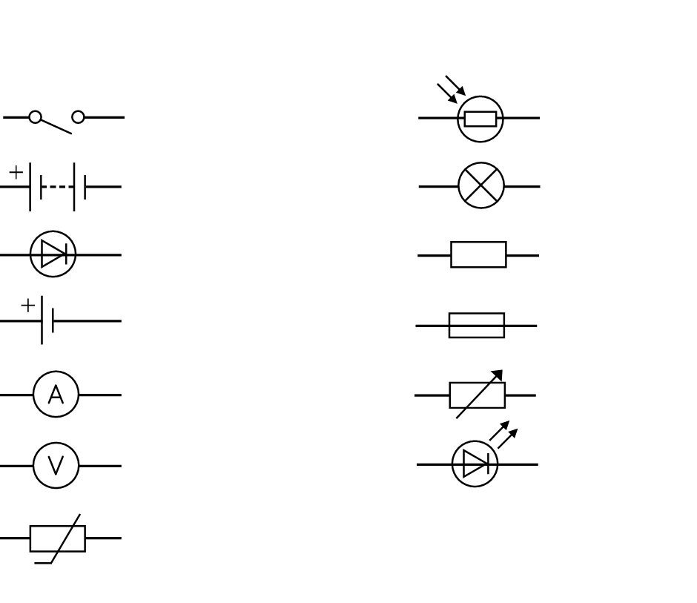
Label IT

Slide 40
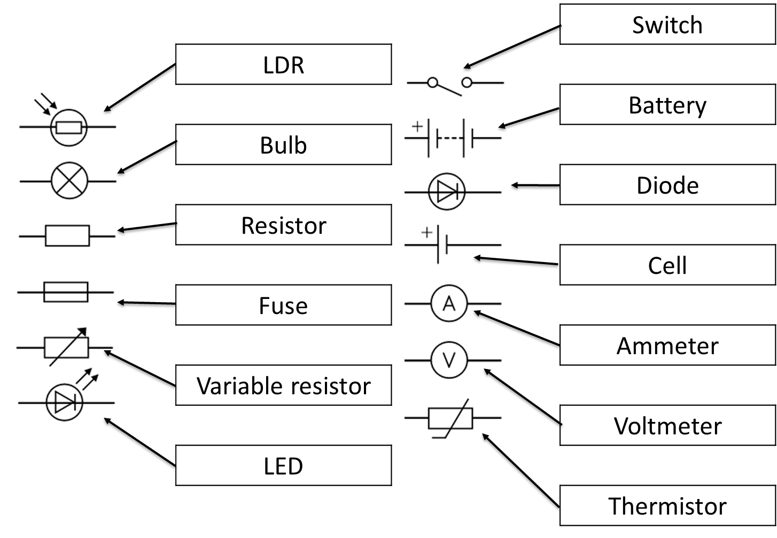
Label IT - Answers

Slide 41
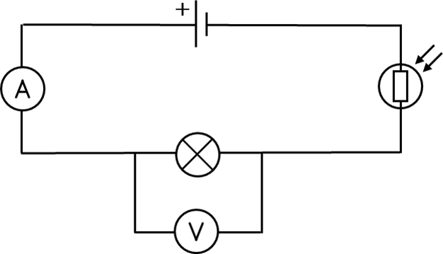
Label IT

Slide 42
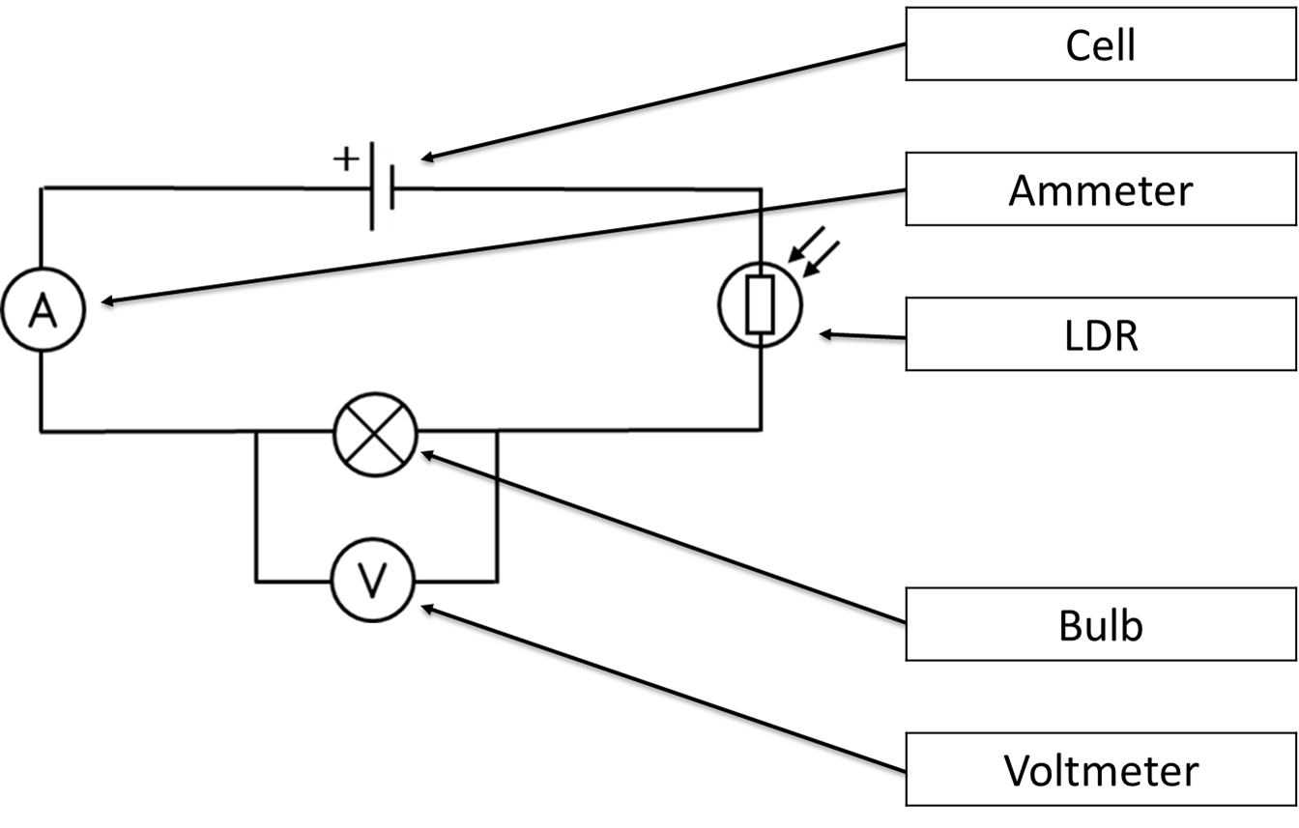
Label IT - Answers

Slide 43
Label IT - Answers
Thermistor |  | Component; resistance decreases as temperature increases
LDR |  | Component; resistance decreases as intensity of light increases
Voltmeter |  | Placed in parallel; measures the potential difference across a component
Ammeter |  | Placed in series; measures the current
Bulb |  | Emits light
Cell |  | Converts chemical energy into electrical energy

Slide 44
The PiXL Club The PiXL Club The PiXL Club The PiXL Club The PiXL Club The PiXL Club The PiXL Club The PiXL Club The PiXL Club The PiXL Club The PiXL Club The PiXL Club The PiXL Club The PiXL Club The PiXL Club The PiXL Club The PiXL Club The PiXL Club The PiXL Club The PiXL Club The PiXL Club The PiXL Club The PiXL Club The PiXL Club The PiXL Club The PiXL Club The PiXL Club The PiXL Club The PiXL Club The PiXL Club The PiXL Club The PiXL Club The PiXL Club The PiXL Club The PiXL Club The PiXL Club The PiXL Club The PiXL Club The PiXL Club The PiXL Club The PiXL Club The PiXL Club The PiXL Club The PiXL Club The PiXL Club XL Club The PiXL Club The PiXL Club The PiXL Club The PiXL Club The PiXL Club The PiXL Club The PiXL Club The PiXL Club The PiXL Club The PiXL Club The PiXL Club The PiXL Club The PiXL Club The PiXL Club The PiXL Club The PiXL Club The PiXL Club The PiXL Club The PiXL Club The PiXL Club The PiXL Club The PiXL Club The PiXL Club The PiXL Club The PiXL Club The PiXL Club The PiXL Club The PiXL Club The PiXL Club The PiXL Club The PiXL Club The PiXL Club The PiXL Club The PiXL Club The PiXL Club The PiXL Club The PiXL Club The PiXL Club The PiXL Club The PiXL Club The PiXL Club The PiXL Club The PiXL Club The PiXL Club The PiXL Club The PiXL Club The PiXL Club The PiXL Club The PiXL Club The PiXL Club The PiXL Club The PiXL Club The PiXL Club The PiXL Club The PiXL Club The PiXL Club The PiXL Club The PiXL Club The PiXL Club The PiXL Club The PiXL Club The PiXL Club The PiXL Club The PiXL Club The PiXL Club The PiXL Club The PiXL Club The PiXL Club The PiXL Club The PiXL Club The PiXL Club The PiXL Club The PiXL Club The PiXL Club The PiXL Club The PiXL Club The PiXL Club The PiXL Club The PiXL Club The PiXL Club The PiXL Club The PiXL Club The PiXL Club The PiXL Club The PiXL Club The PiXL Club The PiXL Club The PiXL Club The PiXL Club The PiXL Club The PiXL Club The PiXL Club The PiXL Club The PiXL Club The PiXL Club The PiXL Club The PiXL Club The PiXL Club The PiXL Club The PiXL Club The PiXL Club The PiXL Club The PiXL Club The PiXL Club The PiXL Club The PiXL Club The PiXL Club The PiXL Club The PiXL Club The PiXL Club The PiXL Club The PiXL Club The PiXL Club The PiXL Club The PiXL Club The PiXL Club The PiXL Club The PiXL Club The PiXL Club The PiXL Club The PiXL Club The PiXL Club The PiXL Club The PiXL Club The PiXL Club The PiXL Club The PiXL Club The PiXL Club The PiXL Club The PiXL Club The PiXL Club The PiXL Club The PiXL Club The PiXL Club The PiXL Club The PiXL Club The PiXL Club The PiXL Club The PiXL Club The PiXL Club The PiXL Club The PiXL Club The PiXL Club The PiXL Club The PiXL Club The PiXL Club The PiXL Club The PiXL Club The PiXL Club The PiXL Club The PiXL Club The PiXL Club The PiXL Club The PiXL Club The PiXL Club The PiXL Club The PiXL Club The PiXL Club The PiXL Club The PiXL Club The PiXL Club The PiXL Club The PiXL Club The PiXL Club The PiXL Club The PiXL Club The PiXL Club The PiXL Club The PiXL Club The PiXL Club The PiXL Club The PiXL Club The PiXL Club The PiXL Club The PiXL Club The PiXL Club The PiXL Club The PiXL Club The PiXL Club The PiXL Club The PiXL Club The PiXL Club The PiXL Club The PiXL Club The PiXL Club The PiXL Club The PiXL Club The PiXL Club The PiXL Club The PiXL Club The PiXL Club The PiXL Club The PiXL Club The PiXL Club The PiXL Club The PiXL Club The PiXL Club The PiXL Club The PiXL Club The PiXL Club The PiXL Club The PiXL Club The PiXL Club The PiXL Club The PiXL Club The PiXL Club The PiXL Club The PiXL Club The PiXL Club The PiXL Club The PiXL Club The PiXL Club The PiXL Club The PiXL Club The PiXL Club The PiXL Club The PiXL Club The PiXL Club The PiXL Club The PiXL Club The PiXL Club The PiXL Club The PiXL Club The PiXL Club The PiXL Club The PiXL Club The PiXL Club The PiXL Club The PiXL Club The PiXL Club The PiXL Club The PiXL Club The PiXL Club The PiXL Club The PiXL Club The PiXL Club The PiXL Club The PiXL Club The PiXL Club The PiXL Club The PiXL Club The PiXL Club The PiXL Club The PiXL Club The PiXL Club The PiXL Club The PiXL Club The PiXL Club The PiXL Club The PiXL Club The PiXL Club The PiXL Club The PiXL Club The PiXL Club The PiXL Club The PiXL Club The PiXL Club The PiXL Club The PiXL Club The PiXL Club The PiXL Club The PiXL Club The PiXL Club The PiXL Club The PiXL Club The PiXL Club The PiXL Club The PiXL Club The PiXL Club The PiXL Club The PiXL Club The PiXL Club The PiXL Club The PiXL Club The PiXL Club The PiXL Club The PiXL Club The PiXL Club The PiXL Club The PiXL Club The PiXL Club The PiXL Club The PiXL Club The PiXL Club The PiXL Club The PiXL Club The PiXL Club The PiXL Club The PiXL Club The PiXL Club The PiXL Club The PiXL Club The PiXL Club The PiXL Club The PiXL Club The PiXL Club The PiXL Club The PiXL Club The PiXL Club The PiXL Club The PiXL Club The PiXL Club The PiXL Club The PiXL Club The PiXL Club The PiXL Club The PiXL Club The PiXL Club The PiXL Club The PiXL Club The PiXL Club The PiXL Club The PiXL Club The PiXL Club The PiXL Club The PiXL Club The PiXL Club The PiXL Club The PiXL Club The PiXL Club The PiXL Club The PiXL Club The PiXL Club The PiXL Club The PiXL Club The PiXL Club The PiXL Club The PiXL Club The PiXL Club The PiXL Club The PiXL Club The PiXL Club The PiXL Club The PiXL Club The PiXL Club The PiXL Club The PiXL Club The PiXL Club The PiXL Club The PiXL Club The PiXL Club The PiXL Club The PiXL Club The PiXL Club The PiXL Club The PiXL Club The PiXL Club The PiXL Club The PiXL Club The PiXL Club The PiXL Club The PiXL Club The PiXL Club The PiXL Club The PiXL Club The PiXL Club The PiXL Club The PiXL Club The PiXL Club The PiXL Club The PiXL Club The PiXL Club The PiXL Club The PiXL Club The PiXL Club The PiXL Club The PiXL Club The PiXL Club The PiXL Club The PiXL Club The PiXL Club The PiXL Club The PiXL Club The PiXL Club The PiXL Club The PiXL Club The PiXL Club The PiXL Club The PiXL Club The PiXL Club The PiXL Club The PiXL Club The PiXL Club The PiXL Club The PiXL Club The PiXL Club The PiXL Club The PiXL Club The PiXL Club The PiXL Club The PiXL Club The PiXL Club The PiXL Club The PiXL Club The PiXL Club The PiXL Club The PiXL Club The PiXL Club The PiXL Club The PiXL Club The PiXL Club The PiXL Club The PiXL Club The PiXL Club The PiXL Club The PiXL Club The PiXL Club The PiXL Club The PiXL Club The PiXL Club The PiXL Club The PiXL Club The PiXL Club The PiXL Club The PiXL Club The PiXL Club The PiXL Club The PiXL Club The PiXL Club The PiXL Club The PiXL Club The PiXL Club The PiXL Club The PiXL Club The PiXL Club The PiXL Club The PiXL Club The PiXL Club The PiXL Club The PiXL Club The PiXL Club The PiXL Club The PiXL Club The PiXL Club The PiXL Club The PiXL Club The PiXL Club The PiXL Club The PiXL Club The PiXL Club The PiXL Club The PiXL Club The PiXL Club The PiXL Club The PiXL Club The PiXL Club The PiXL Club The PiXL Club The PiXL Club The PiXL Club The PiXL Club The PiXL Club The PiXL Club The PiXL Club The PiXL Club The PiXL Club The PiXL Club The PiXL Club The PiXL Club The PiXL Club The PiXL Club The PiXL Club The PiXL Club The PiXL Club The PiXL Club The PiXL Club The PiXL Club The PiXL Club The PiXL Club The PiXL Club The PiXL Club The PiXL Club The PiXL Club The PiXL Club The PiXL Club The PiXL Club The PiXL Club The PiXL Club The PiXL Club The PiXL Club The PiXL Club The PiXL Club The PiXL Club The PiXL Club The PiXL Club The PiXL Club The PiXL Club The PiXL Club The PiXL Club The PiXL Club The PiXL Club The PiXL Club The PiXL Club The PiXL Club The PiXL Club The PiXL Club The PiXL Club The PiXL Club The PiXL Club The PiXL Club The PiXL Club The PiXL Club The PiXL Club The PiXL Club The PiXL Club The PiXL Club The PiXL Club The PiXL Club The PiXL Club The PiXL Club The PiXL Club The PiXL Club The PiXL Club The PiXL Club The PiXL Club The PiXL Club The PiXL Club The PiXL Club The PiXL Club The PiXL Club The PiXL Club The PiXL Club The PiXL Club The PiXL Club The PiXL Club The PiXL Club The PiXL Club The PiXL Club The PiXL Club The PiXL Club The PiXL Club The PiXL Club The PiXL Club The PiXL Club The PiXL Club The PiXL Club The PiXL Club The PiXL Club The PiXL Club The PiXL Club The PiXL Club The PiXL Club The PiXL Club The PiXL Club The PiXL Club The PiXL Club The PiXL Club The PiXL Club The PiXL Club The PiXL Club The PiXL Club The PiXL Club The PiXL Club The PiXL Club The PiXL Club The PiXL Club The PiXL Club The PiXL Club The PiXL Club The PiXL Club The PiXL Club The PiXL Club The PiXL Club The PiXL Club The PiXL Club The PiXL Club The PiXL Club The PiXL Club The PiXL Club The PiXL Club The PiXL Club The PiXL Club The PiXL Club The PiXL Club The PiXL Club The PiXL Club The PiXL Club The PiXL Club The PiXL Club The PiXL Club The PiXL Club The PiXL Club The PiXL Club The PiXL Club The PiXL Club The PiXL Club The PiXL Club The PiXL Club The PiXL Club The PiXL Club The PiXL Club The PiXL Club The PiXL Club The PiXL Club The PiXL Club The PiXL Club The PiXL Club The PiXL Club The PiXL Club The PiXL Club The PiXL Club The PiXL Club The PiXL Club The PiXL Club The PiXL Club The PiXL Club The PiXL Club The PiXL Club The PiXL Club The PiXL Club The PiXL Club The PiXL Club The PiXL Club The PiXL Club The PiXL Club The PiXL Club The PiXL Club The PiXL Club The PiXL Club The PiXL Club The PiXL Club The PiXL Club The PiXL Club The PiXL Club The PiXL Club The PiXL Club The PiXL Club The PiXL Club The PiXL Club The PiXL Club The PiXL Club The PiXL Club The PiXL Club The PiXL Club The PiXL Club The PiXL Club The PiXL Club The PiXL Club The PiXL Club The PiXL Club The PiXL Club The PiXL Club The PiXL Club The PiXL Club The PiXL Club The PiXL Club The PiXL Club The PiXL Club The PiXL Club The PiXL Club The PiXL Club The PiXL Club The PiXL Club The PiXL Club The PiXL Club The PiXL Club The PiXL Club The PiXL Club The PiXL Club The PiXL Club The PiXL Club The PiXL Club The PiXL Club The PiXL Club The PiXL Club The PiXL Club The PiXL Club The PiXL Club The PiXL Club The PiXL Club The PiXL Club The PiXL Club The PiXL Club The PiXL Club The PiXL Club The PiXL Club The PiXL Club The PiXL Club The PiXL Club The PiXL Club The PiXL Club The PiXL Club The PiXL Club The PiXL Club The PiXL Club The PiXL Club The PiXL Club The PiXL Club The PiXL Club The PiXL Club The PiXL Club The PiXL Club The PiXL Club The PiXL Club The PiXL Club The PiXL Club The PiXL Club The PiXL Club The PiXL Club The PiXL Club
PiXL GetIT!
GCSE Physics
Topic – Energy
© Copyright The PiXL Club Ltd, 2017
This resource is strictly for the use of member schools for as long as they remain members of The PiXL Club. It may not be copied, sold nor transferred to a third party or used by the school after membership ceases. Until such time it may be freely used within the member school.
All opinions and contributions are those of the authors. The contents of this resource are not connected with nor endorsed by any other company, organisation or institution.
www.pixl.org.uk The PiXL Club Ltd, Company number 07321607

Slide 45
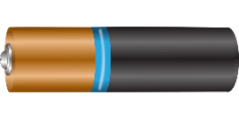
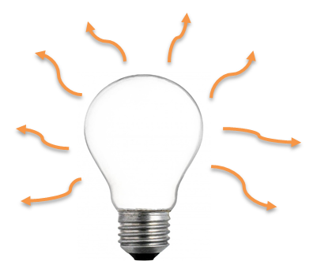
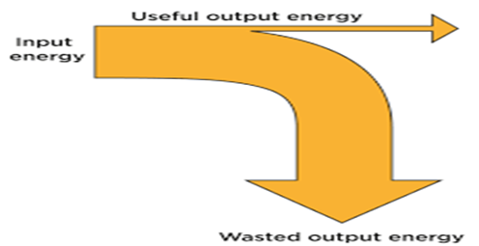
GetIT – Energy
Energy cannot be created or destroyed; energy is conserved. The unit for energy is joules.
Energy can be:
stored
transferred
dissipated
We can calculate how efficient an energy transfer is using this equation:
Efficiency = useful output energy
total input energy

Slide 46
Match IT
System |  | Heat
Kinetic energy |  | Unit for power
Thermal energy |  | Unwanted energy transfer; energy is ‘wasted’
Specific heat capacity |  | Object or group of objects
Watt |  | Rate at which energy is transferred
Dissipation |  | Found in a moving object
Renewable |  | Fossil fuels – supplies will run out
Non-renewable |  | Energy needed to raise the temperature of 1Kg of a substance by 1ºC
Power |  | Supplies will be replenished

Slide 47
Match IT - Answers
System |  | Object or group of objects
Kinetic energy |  | Found in a moving object
Thermal energy |  | Heat
Specific heat capacity |  | Energy needed to raise the temperature of 1Kg of a substance by 1ºC
Watt |  | Unit for power
Dissipation |  | Unwanted energy transfer; energy is ‘wasted’
Renewable |  | Supplies will be replenished
Non-renewable |  | Fossil fuels – supplies will run out
Power |  | Rate at which energy is transferred

Slide 48
Label IT
Label the diagram to show the energy transfers occurring in the light bulb.

Slide 49
Label IT
Label the diagram to show the energy transfers occurring in the light bulb.
Electrical energy
Light energy
Thermal energy

Slide 50
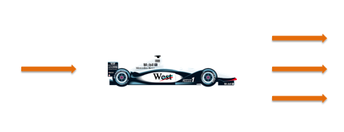
Label IT - Answers
Chemical in fuel
Thermal in heated objects
Sound in vibrating objects
Kinetic in moving objects
The remaining three energy types could be on any of the three remaining arrows

